Slide 1
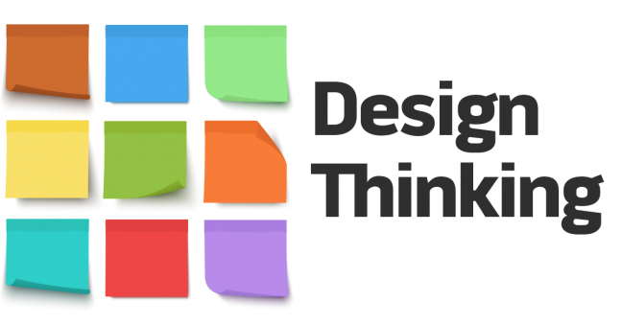

Slide 2

Noida Institute of Engineering and Technology, Greater Noida
Unit: 3
Subject: DESIGN THINKING I
ACSE-0202
Harsh Awasthi
Assistant professor
Department of MBA
Course Details B Tech 2nd Sem

Slide 3
CONTENT
Defining the problem statement,
Creating personas
Research- identifying drivers
Information gathering, Target groups
Samples, Feedbacks
Idea Generation-basic design directions,
brainstorming,
idea evaluation,
double diamond approach,
“How Might We”, Defining the problem using Ice-Cream Sticks,
Mind-Map,
Ideation activity games

Slide 4
COURSE OBJECTIVE
The objective of this course is to familiarize students with design thinking process as a tool for breakthrough innovation. It aims to equip students with design thinking skills and ignite the minds to create innovative ideas, develop solutions for real-time problems

Slide 5
COURSE OUTCOME
After completion of this course, students will be able to-
Develop a strong understanding of the design process and apply it in a variety of business settings
Analyze self, culture, teamwork to work in a multidisciplinary environment and exhibit empathetic behavior
Formulate specific problem statements of real time issues and generate innovative ideas using design tools
Apply critical thinking skills in order to arrive at the root cause from a set of likely causes
Demonstrate an enhanced ability to apply design thinking skills for evaluation of claims and arguments

Slide 6
CO-PO Mapping
CO | PO-1 | PO-2 | PO-3 | PO-4 | PO-5 | PO-6 | PO-7 | PO-8 | PO-9 | PO-10 | PO-11 | PO-12
CO1 | 1 | 2 | 2 | 1 | 1 | 1 | 2 | 1 | 2 | 2 | 2 | 2
CO2 | 1 | 2 | 1 | 1 | 1 | 2 | 1 | 2 | 2 | 2 | 1 | 2
CO3 | 1 | 2 | 1 | 2 | 2 | 1 | 2 | 1 | 2 | 2 | 1 | 2
CO4 | 1 | 2 | 1 | - | - | 1 | 1 | - | 1 | 1 | - | 2
CO5 | 1 | 2 | 1 | - | - | 1 | 1 | - | 1 | 1 | - | 2
Mean | 1 | 2 | 1.2 | 1.3 | 1.3 | 1.2 | 1.4 | 1.3 | 1.6 | 1.6 | 1.3 | 2

Slide 7
Prerequisite
Basic knowledge of Design Thinking
Understanding and ability to empathize

Slide 8
Topic Outcome
After completion of these topics, students will be able to-
Formulate specific problem statements of real time issues and generate innovative ideas using design tools
Use modern online tools in Design Thinking process

Slide 9
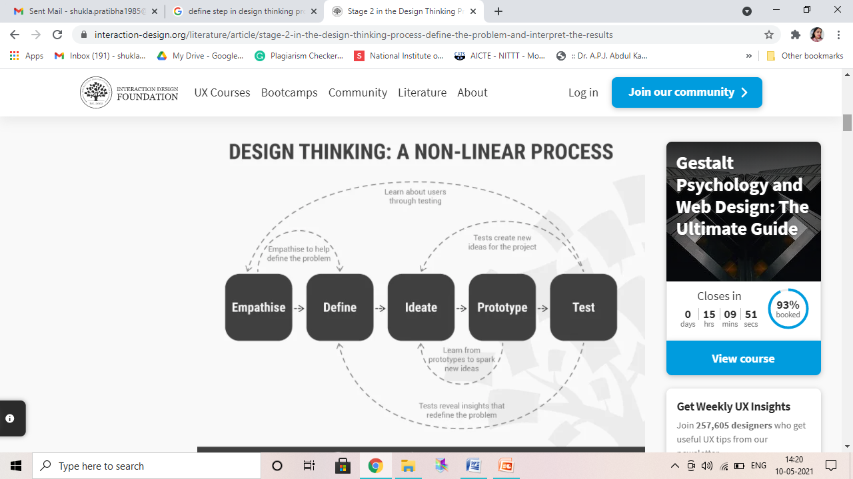
DEFINE (CO3)

Slide 10
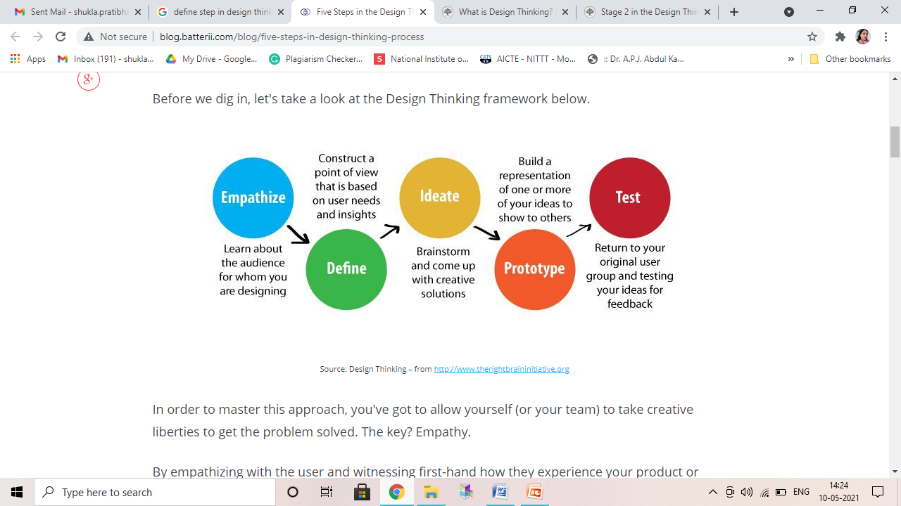
DEFINE (CO3)

Slide 11
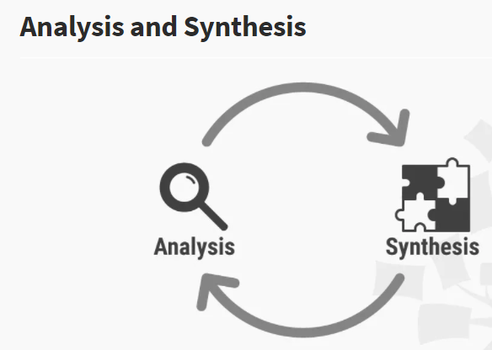
DEFINE (CO3)
Analysis is about breaking down complex concepts and problems into smaller, easier-to-understand constituents.
Synthesis, on the other hand, involves creatively piecing the puzzle together to form whole ideas.
In the Define stage you synthesise your observations about your users from the first stage, the Empathise stage.

Slide 12
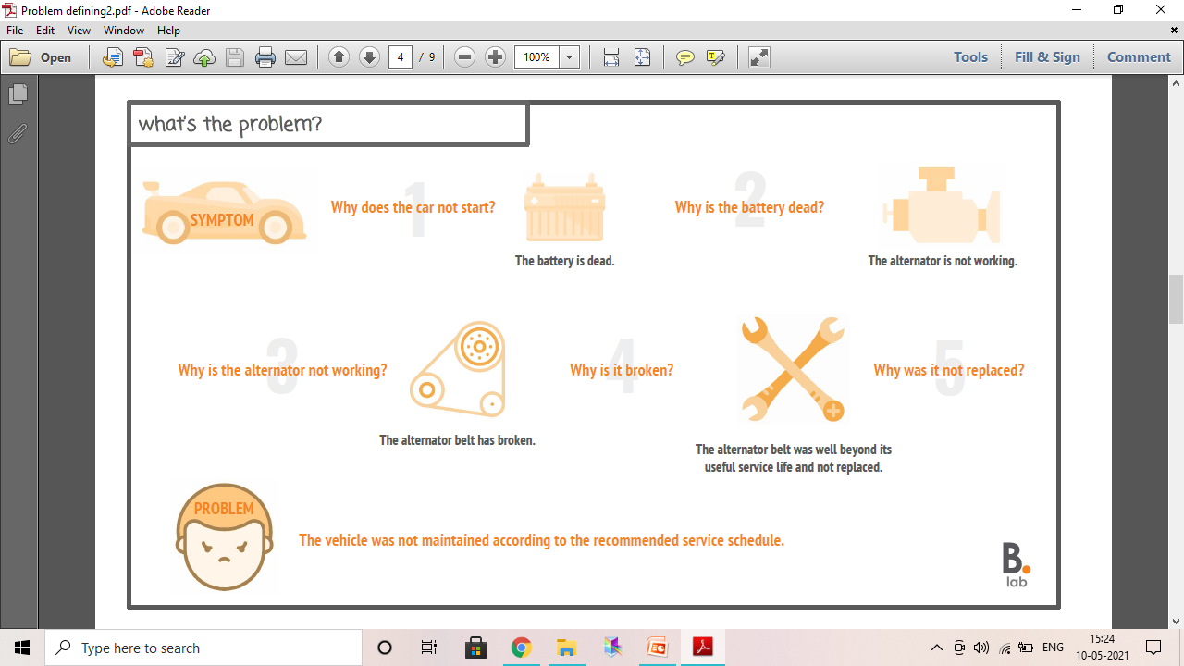
What’s the Problem(CO3)

Slide 13
What Makes a Good Problem Statement? (CO3)
A problem statement is important to a Design Thinking project, because:
It will guide you and your team and provides a focus on the specific needs that you have uncovered.
It also creates a sense of possibility and optimism that allows team members to spark off ideas in the Ideation stage, which is the third and following stage in the Design Thinking process.
A good problem statement should thus have the following traits:
Human-centered
Broad enough for creative freedom
Narrow enough to make it manageable
Problem Statements are like Compasses in the Wilderness of Ideation

Slide 14
PROBLEM STATEMENT (CO3)
Problem statements should be:
Human-centered: Frame problem statements from insights about users and their needs.
Have the right scope:
Broad enough to permit creative freedom, so you don’t concentrate too narrowly on specific methods for implementing solutions or describing technical needs; but
Narrow enough to be practicable, so you can eventually find specific solutions.
Based on an action-oriented verb (e.g., “create” or “adapt”).
Fully developed and assumption-free.

Slide 15
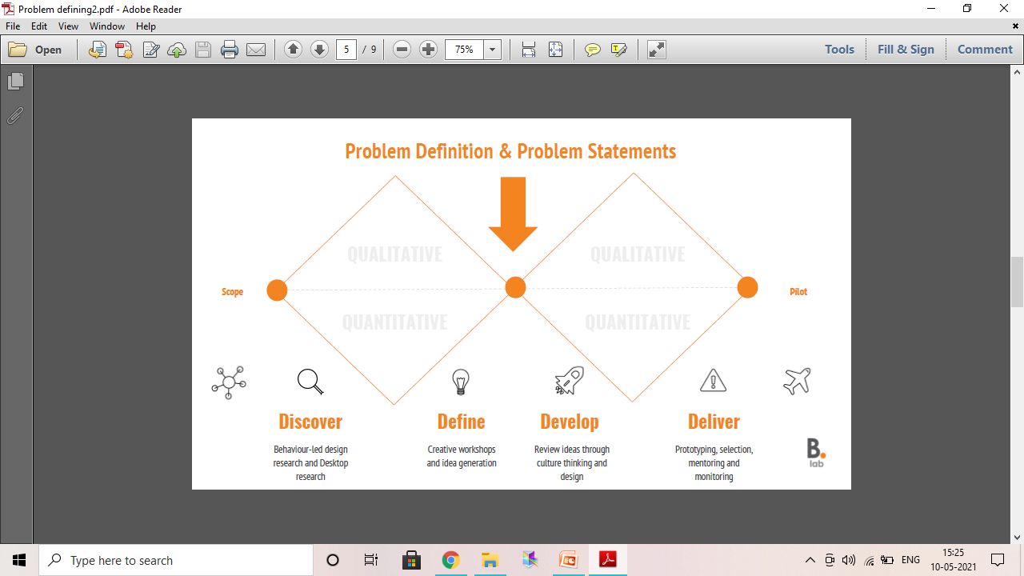
PROBLEM STATEMENT (CO3)

Slide 16
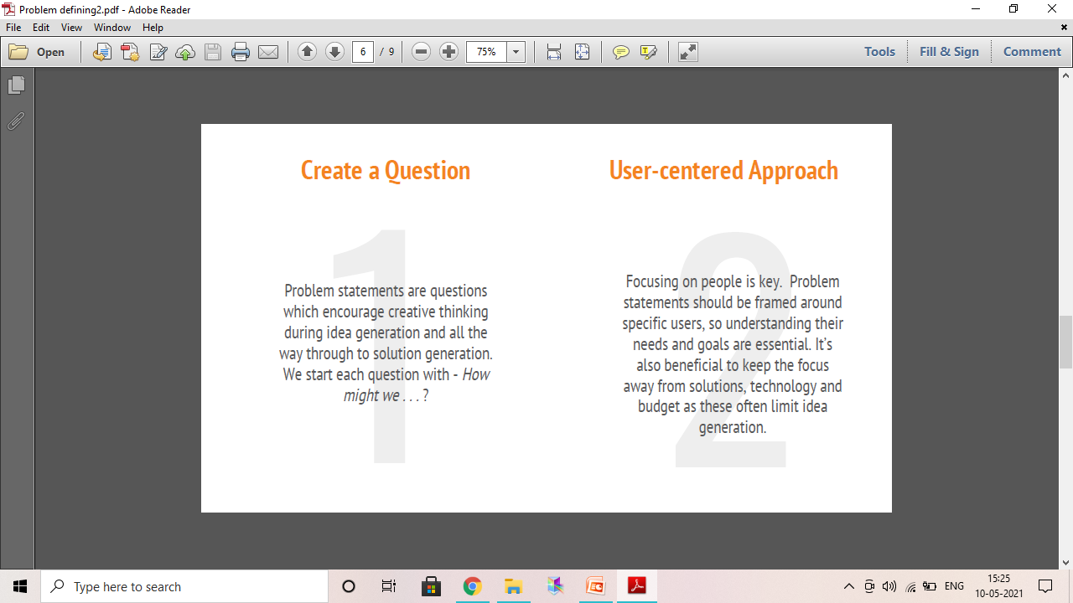
PROBLEM STATEMENT (CO3)

Slide 17
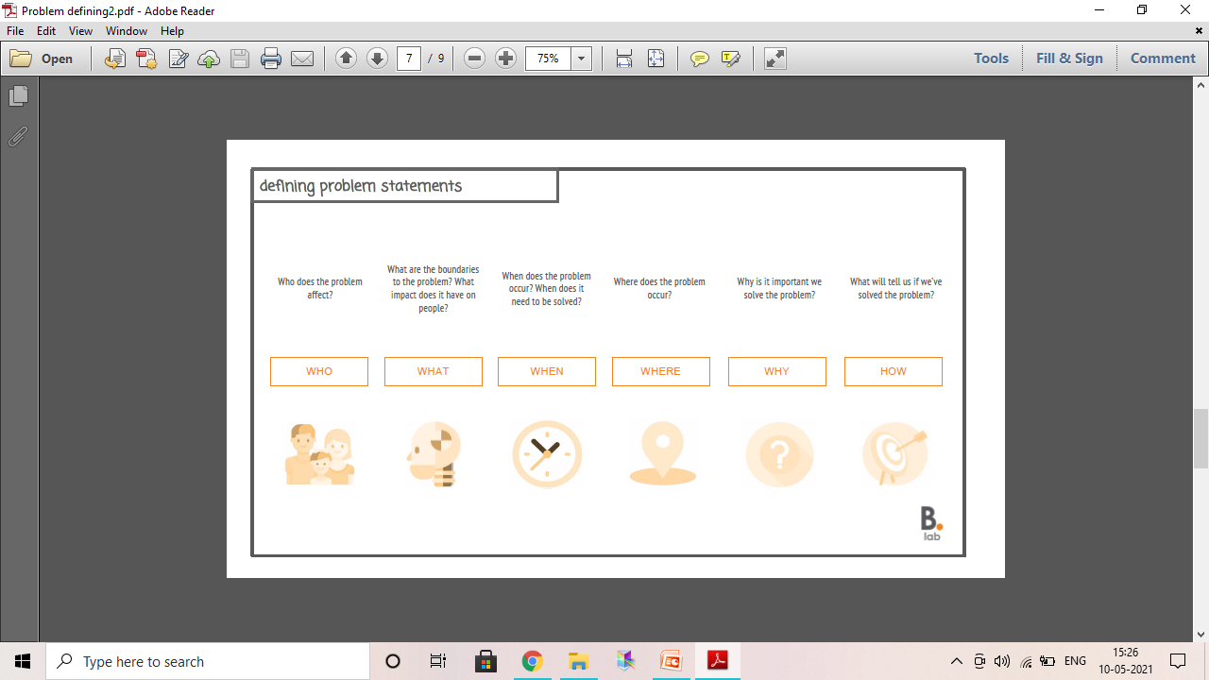
DEFINING PROBLEM STATEMENT (CO3)

Slide 18
PERSONAS (CO3)
Personas are fictional characters, which you create based upon your research in order to represent the different user types that might use your service, product, site, or brand in a similar way.
Creating personas will help you to:
Understand your users’ needs, experiences, behaviours and goals.
Help you step out of yourself.
Help you to recognise that different people have different needs and expectations.
Help you to identify with the user you’re designing for. Personas make the design task at hand less complex, they guide your ideation processes, and they can help you to achieve the goal of creating a good user experience for your target user group.

Slide 19
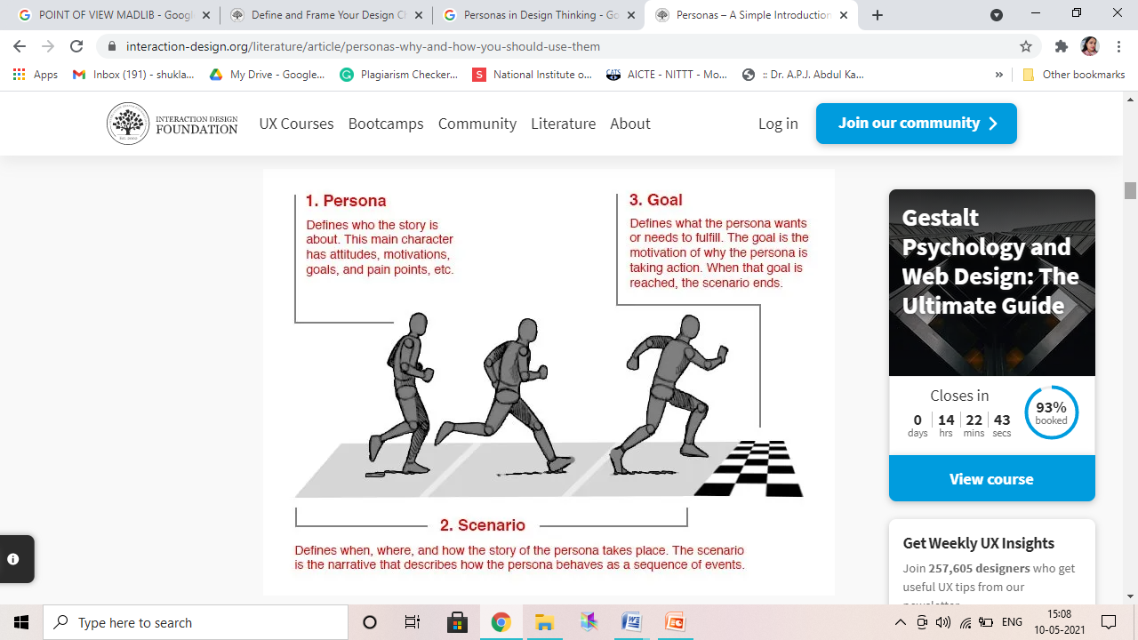
PERSONAS (CO3)

Slide 20
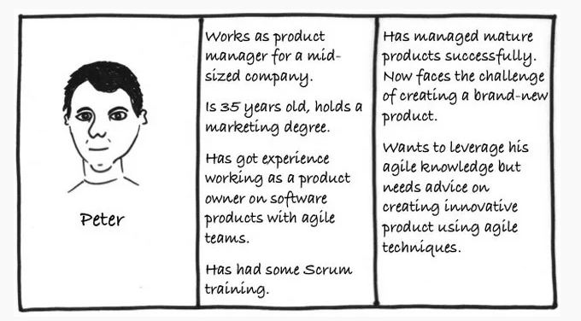
PERSONAS (CO3)
Lene Nielsen’s model, which sets out to cover this problem through a 10‑step process of creating an engaging persona.

Slide 21
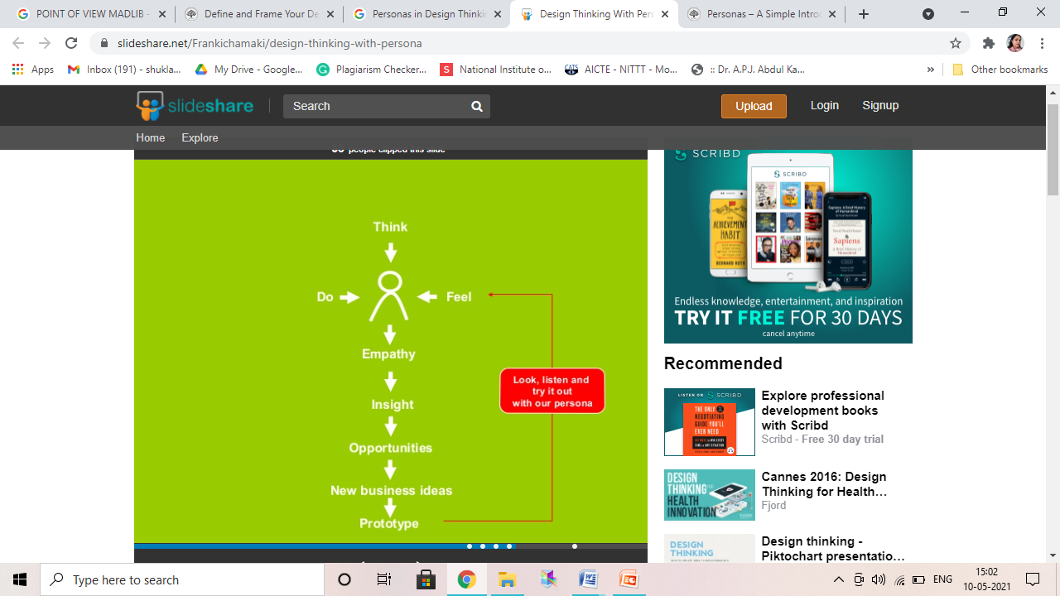
PERSONAS (CO3)

Slide 22
10 STEPS TO PERSONAS (CO3)
1. Collect data.
2. Form a hypothesis.
3. Everyone accepts the hypothesis.
4. Establish a number.
5. Describe the personas.
6. Prepare situations or scenarios for your personas.
7. Obtain acceptance from the organisation.
8. Disseminate knowledge.
9. Everyone prepares scenarios.
10. Make ongoing adjustments.
10-step process as described by Lene Nielsen

Slide 23
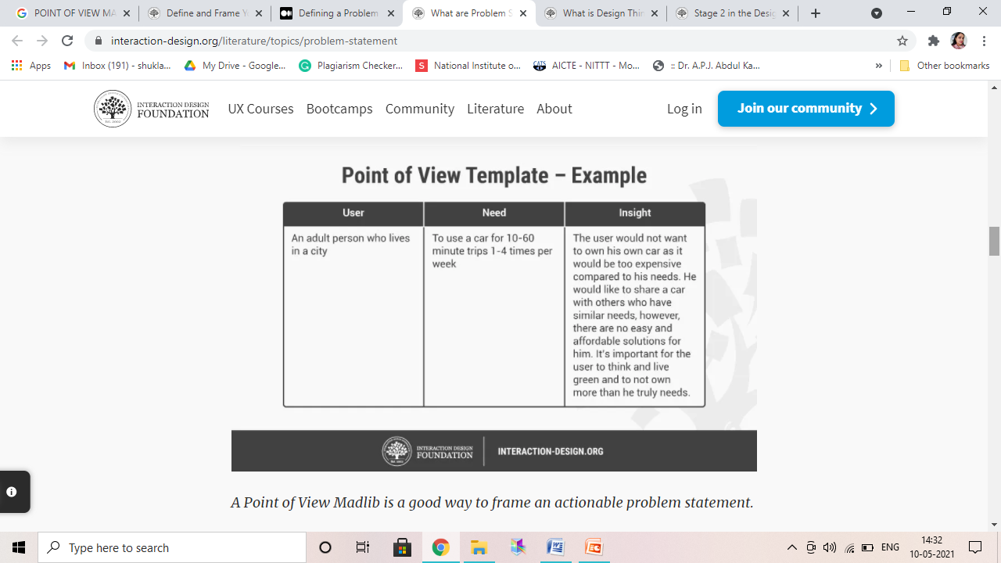
POINT OF VIEW MADLIB (CO 3)
To define a problem statement, your team must first examine recorded observations about users. You must capture your users’ exact profile in the problem statement or POV. So, you need to synthesize research results and produce insights that form solid foundations.

Slide 24
POINT OF VIEW MADLIB (CO 3)
The POV madlib is a framework you use to place the user, need and insight in the best way.
You have a good problem statement if team members:
Feel inspired.
Have the criteria to evaluate ideas.
Can use it to guide innovation efforts.
Can’t find a cause or a proposed solution in it (which would otherwise get in the way of proper ideation).

Slide 25
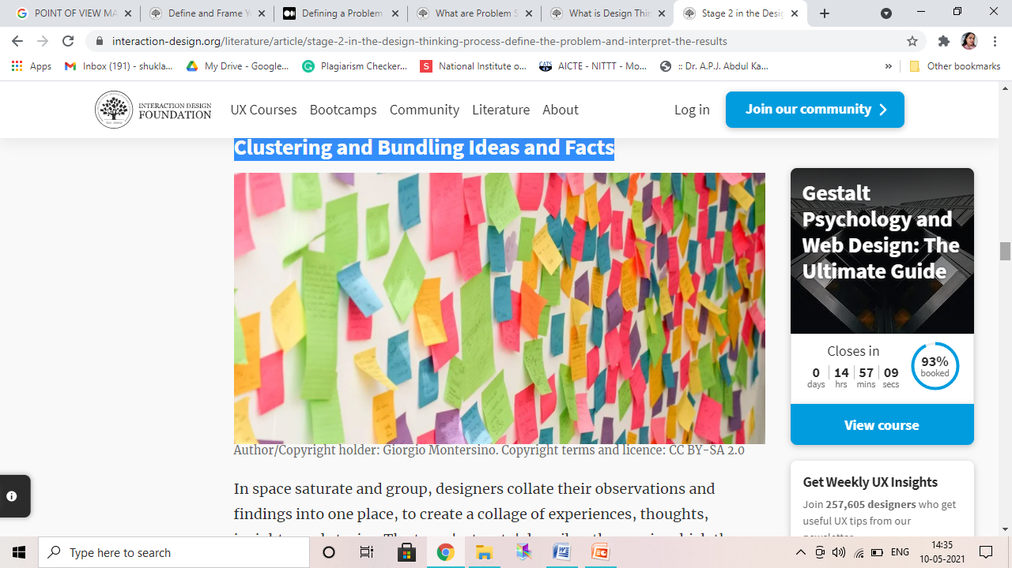
Space Saturate and Group and Affinity Diagrams (CO3)
Clustering and Bundling Ideas and Facts
Helps to draw connections between these individual elements, or nodes, to connect the dots, and to develop new and deeper insights, which help define the problem(s) and develop potential solutions. In other words: go from analysis to synthesis.

Slide 26
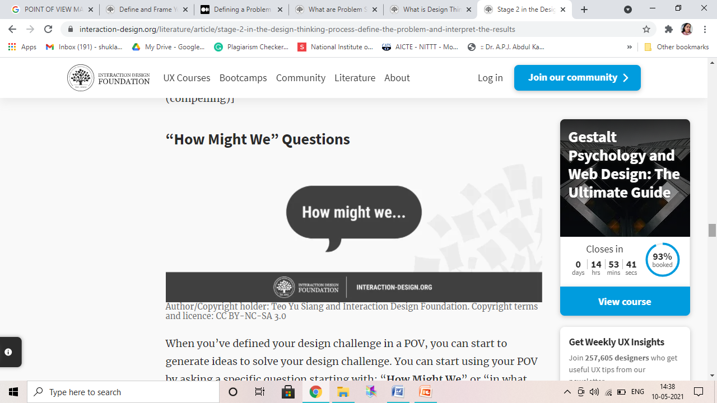
HOW MIGHT WE (CO3)
How Might We (HMW) questions are questions that have the potential to spark ideation sessions such as brainstorms. They should be broad enough for a wide range of solutions, but narrow enough that specific solutions can be created for them.
“How Might We” questions should be based on the observations you’ve gathered in the Empathise stage of the Design Thinking process.

Slide 27
DEFINE (CO3)
Define stage involves collating data from the observation stage (first stage called Empathise) to define the design problems and challenges.
By using methods for synthesizing raw data into a meaningful and usable body of knowledge:
Empathy mapping and space saturate and group — we will be able to create an actionable design problem statement
Point of View that inspire the generation of ideas to solve it.
How Might We questions open up to Ideation sessions where you explore ideas, which can help you solve your design challenge in an innovative way.

Slide 28
DEFINE (CO3)
Design thinkers ask four important questions:
Who
What
Where
Why

Slide 29
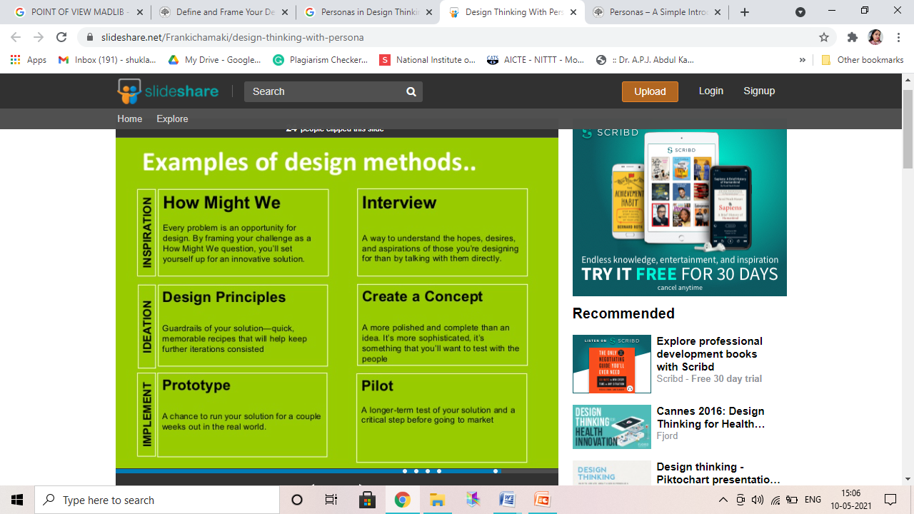
DEFINE (CO3)

Slide 30
RESEARCH

Slide 31
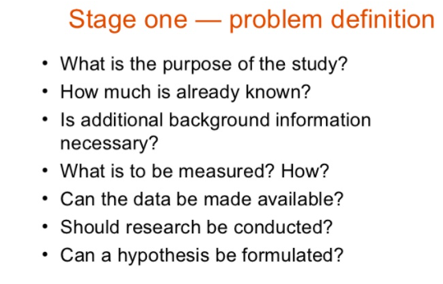
Daily Quiz

Slide 32
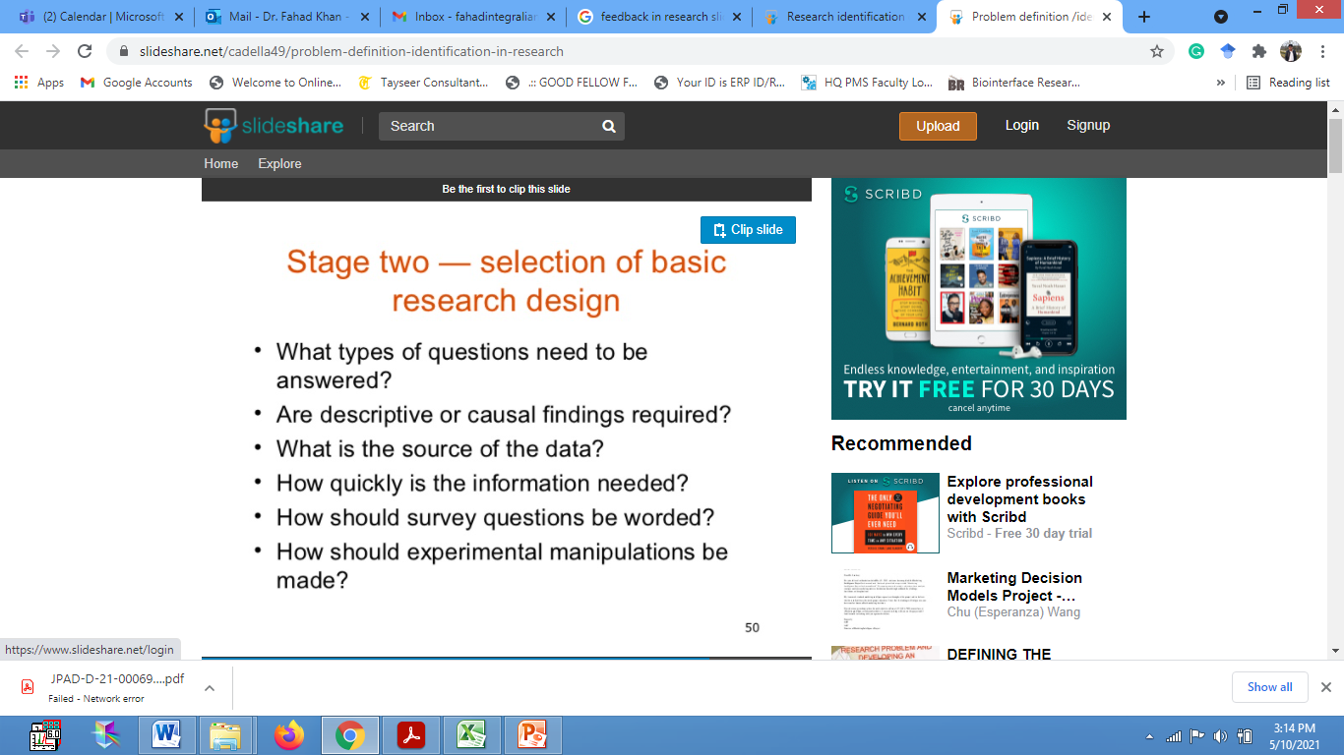
Daily Quiz

Slide 33

Daily Quiz

Slide 34
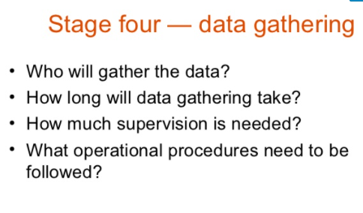
Daily Quiz

Slide 35
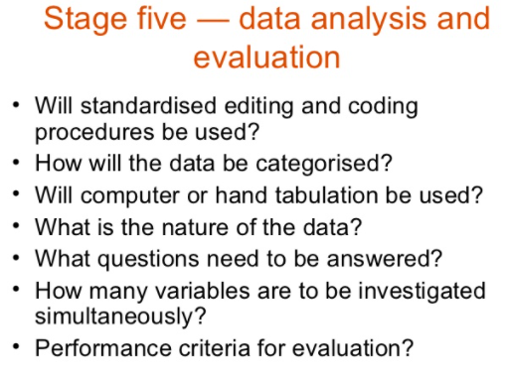
Daily Quiz

Slide 36
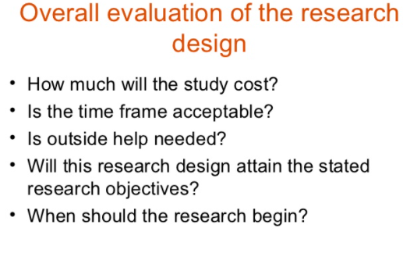
Daily Quiz

Slide 37
Faculty Video Links, Youtube & NPTEL Video Links and Online Courses Details
Ideation https://www.youtube.com/watch?v=xXsHI_VlhmY https://www.youtube.com/watch?v=zbLxs6te5to
Brainstorming https://www.ideou.com/pages/brainstorming https://www.youtube.com/watch?v=zxzfGWoaXcM

Slide 38
MCQ s
Ramesh is creating a new product. He takes a design-thinking approach. His first step is addressing who she is creating the product for and conducts research on understanding this target market. What is this step in the design thinking process?
Define
Ideate
Empathise
Prototype
A stakeholder is …?
Anyone who is involved in the project
Anyone positively or negatively impacted by the project
Anyone who can influence the direction of the project
Anyone who can impact/be impacted positively or negatively by the project

Slide 39
Expected Questions for University Exam
What is the define stage and why is it necessary?
Why is the define stage so important?
What is a problem statement?
What makes a good problem statement?
How to write a meaningful problem statement
What comes after the define phase?
How 5 Why’s it helps in defining problem statement?

Slide 40
Weekly Assignment
Read the scenario and suggest your solution
Whole Bank is a US bank, initially based in Framingham, Massachusetts, created with the mission to help customers save and manage their money using innovative options e.g. virtual currencies. They have specifically identified a problem for bank customers who use their debit/credit cards while travelling. So they would like to develop a tool to let the bank customers pay without having to use the physical card and create a better user experience for their clients.

Slide 41
Lecture

Slide 42
Recap

Slide 43
Topic Outcome
After completion of these topics, students will be able to-
Understand Ideation and Brainstorming process and tools

Slide 44
IDEATION (CO3)
Ideation is the process where you generate ideas and solutions through sessions such as Sketching, Prototyping, Brainstorming, Brainwriting, Worst Possible Idea, and a wealth of other ideation techniques. Ideation is also the third stage in the Design Thinking process. Participants gather with open minds to produce as many ideas as they can to address a problem statement in a facilitated, judgment-free environment.
Ideation process is characterized by the alternation of divergent and convergent thinking, typical of design thinking process.
To achieve divergent thinking, it may be important to have a diverse group of people involved in the process. Design teams typically begin with a structured brainstorming process of "thinking outside the box." Convergent thinking, on the other hand, aims for zooming and focusing on the different proposals to select the best choice, which permits continuation of the design thinking process to achieve the final goals.
Notes:
After collecting and sorting many ideas, a team goes through a process of pattern finding and synthesis in which it has to translate ideas into insights that can lead to solutions or opportunities for change. These might be either visions of new product offerings, or choices among various ways of creating new experiences.

Slide 45
IDEATION (CO3)
Ideation Will Help You:
Ask the right questions and innovate with a strong focus on your users, their needs, and your insights about them.
Step beyond the obvious solutions and therefore increase the innovation potential of your solution.
Bring together perspectives and strengths of your team members.
Uncover unexpected areas of innovation.
Create volume and variety in your innovation options.
Get obvious solutions out of your heads, and drive your team beyond them.

Slide 46
IDEATION (CO3)
Characteristics Required for Successful Ideation
Ideation requires purposefully adopting certain characteristics, whether they are natural or whether they need to be encouraged and learnt. Regardless of one's personality or way of thinking, we all fall into the trap of sticking to patterns and familiar ground, and tend to use the same recipes for solving problems, as this reduces the cognitive load required. Experts and novices alike need to be constantly self-aware and purposely intend to adopt some of the following characteristics, which create an open mind and fertile ground for sparking unconventional ideas.

Slide 47
Characteristics Required for Successful Ideation
IDEATION (CO3)
Adapting: Be able to switch how you see, understand, and extend thinking as new input gets generated.
Connecting: Be able to connect seemingly unrelated concepts, attributes or themes in order to create new possibilities.
Disrupting: Be able to overturn commonly held beliefs, assumptions or norms in order to re-think conventional approaches.
Flipping: Turn dead-ends or deadlocks into opportunities by flipping them over or rapidly changing direction towards greater viability.
Dreaming and Imagining: Be able to visualise a new picture of reality by turning abstract needs into tangible pictures or stories, thereby allowing the space required for inventing bridges to that reality.
Experimental: Be open and curious enough to explore possibilities and take risks; be willing and eager to test out ideas and eager to venture into the unknown.
Recognise Patterns: Seek to spot common threads of meaning, and ways of seeing, doing and behaving; be able to recognise attributes or shared values across a spectrum of influence and input; and finally be able to utilize these commonalities to build solutions.
Curiosity: Be willing to ask uncomfortable, silly or even crazy questions. Be willing to explore and experience, in order to understand and learn something new and different.

Slide 48
Five Themes Of Design Thinking (CO3)
Design Thinking is a tricky concept to define. Depending on who you ask, it’s either a process, a framework, a state of mind, or some combination of all of these.
Considering this ambiguity and the difficulty it presents design thinking researchers, Carlgren, Rauth & Elmquist (2016) attempted to pin down a useful definition of design thinking that can be applied in research projects going forward. What they discovered is useful not only to this end, but also for practitioners currently looking to apply design thinking for social innovation.

Slide 49
After a comprehensive review of the extant literature on design thinking*, Carlgren, Rauth & Elmquist (2016) were able to identify five themes of characteristic of design thinking. These themes arose from analysis of design thinking procedures in six companies of various sizes that self-identified as practitioners of design thinking. The themes generally align with the previous research in the field, though similar concepts were bunched under one broader theme for clarity. The five characteristic themes follow, along with thoughts about how they might be applied in a sport for development program:
Five Themes Of Design Thinking (CO3)

Slide 50
Five Themes Of Design Thinking (CO3)
User Focus
The needs of the end user not only need to be considered with empathy and understanding, but the users themselves should also be involved in the design thinking process.
In a sport for development context this would mean including the athletes themselves – including current athletes and alumni who have gone through the program and have the benefit of hindsight to help them identify improvements that might be made.
Problem Framing
Rather than attempting to ‘isolate’ the problem, the scope of the problem should instead be expanded to ensure no possible solutions are missed.
The “problem” with a sport for development program may not even look like a problem at all. It may be a case of fixing what “ain’t broke” in order to improve facets of the program across the board. Rather than waiting for complaints to arise, it’s about looking around and asking ourselves: “how can we do better?”

Slide 51
Five Themes Of Design Thinking (CO3)
Visualization
Use either graphical or physical representations of proposed solutions (products) in a rapid prototyping process that involves frequent failure in order to succeed more meaningfully.
Prototyping is an especially powerful tool for sport for development programs and may include role playing in order to better understand the challenges being faced by different stakeholders.
Experimentation
This is the process of moving through iterations of the design and not being afraid to revisit previous iterations if the current one isn’t satisfactory.
As you work through your prototypes, don’t be discouraged if you hit a snag. Simply take a step back to what you know was working and begin anew the search for additional value.

Slide 52
Five Themes Of Design Thinking (CO3)
Diversity
Members of the design thinking team should have different skills, experience, interests, and personalities.
This is rather simple to accomplish in a sport for development program, as stakeholders typically bring all of these brands of diversity to the table without the need to specifically seek it out. Parents, volunteers and participants will all bring something unique to the design thinking process, but it’s not necessary to stop there.
Flexibility Is Key
Interestingly (and yet consistent with the varied nature of conceptualisations of design thinking seen in the academic and popular literature), each company engaged with each of these five themes in the design thinking processes but with different prioritizations of one or more themes over others. Clearly, the themes are adaptable across myriad contexts.
Such a flexible framework is sure to hold value for the design of your own sport for development program. I’d love to hear how you go with applying any of the above – please don’t hesitate to use the contact form to reach out.

Slide 53
Observation
INSPIRATION (CO3)
The inspiration phase is where the team conducts the design research that can be considered the core of all the news phases. By the end of this phase, the team should have a clear understanding about the design challenge need to be addressed, a project plan for the timeline, budget, and team. This stage is crucial to ensure the success of the project as it is considered a pivot point where the different stages need to use to during the measurements and iteration after each of the ideation and implementation phases.
Inclusion is all about creating an enabling environment where people can bring their authentic selves to work and feel valued, involved, connected and respected.

Slide 54
Why is Inclusive Design Important?
INSPIRATION (CO3)
When everyone feels valued and seen, inclusive design can also help your business flourish. After all, how your systems, products, and business processes work can expand your reach as a company, spark innovation—or not.
When I talk about ideas of inclusion, especially during the customer recruitment phase of a design research project, I hear a lot from clients and product owners “Oh, but this project isn’t about that.” But I always insist because it always benefits the learning and the solution. For example, a design research project I recently led recruited a customer who had a very different upbringing than most of our other customers; he was bi-racial and had grown up in poverty. His perspective and stories were unlike anything we’d heard in our previous dozen interviews. He inspired us in a new and different way to develop a new product concept that we think will serve and delight all types of customers.

Slide 55
BRAINSTORMING (CO3)
At its most basic level, a Brainstorm session involves sprouting related points from a central idea. Brainstorming is one of the primary methods employed during the Ideation stage of a typical Design Thinking process. Brainstorming is a great way to generate many ideas by leveraging the collective thinking of the group, engaging with each other, listening, and building on other ideas. This method involves focusing on one problem or challenge at a time, while team members build on each other’s responses and ideas with the aim of generating as many potential solutions as possible. These can then be refined and narrowed down to the best solution(s). Participants must then select the best, the most practical, or the most innovative ideas from the options they’ve come up with.

Slide 56
brainstorming rules from the Institute of Design at Stanford (d.school) and the successful design company, IDEO who celebrates Design Thinking. (CO3)
Set a time limit
Start with a problem statement, point of view, possible questions, a plan, or a goal and stay focused on the topic: Identify the core subject or the main aim of the exercise. For example, what are you trying to achieve? Are you trying to improve a certain feature? Are you focusing on ways to improve the overall experience? Condense the main issue into a problem statement and condense it into a short “How Might We” sentence. You may even be able to synthesise this into single word. Your ideas should always branch off from this central headline.
Stay on Topic: It is easy to veer off and take lots of different directions during brainstorming sessions, especially when you are trying to be open-minded and unconstrained in your efforts to come up with ideas. It is important that members stay on topic. Focus is essential; otherwise, the process can become confusing, or ideas can become muddled and cross between solutions for other problems. Every effort should be made by the facilitator to keep members on the central theme and goal. You might even want to designate a particular brainstormer to maintain the thread and prevent team members veering off course.
Defer judgement or criticism, including non-verbal: The brainstorming environment is not the time to argue or for questioning other members’ ideas; each member has a responsibility to foster relations that advance the session. For this reason, judgement comes later so rather than blocking an idea, you and your other team members are encouraged to come up with your own ideas that sprout off from those provided by the other members of your team.

Slide 57
brainstorming rules from the Institute of Design at Stanford (d.school) and the successful design company, IDEO who celebrates Design Thinking. (CO3)
5. Encourage weird, wacky and wild ideas: Once again, as brainstorming is a creative activity, each member should try to encourage other members and create an environment in which they feel comfortable verbalising their ideas. Free thinking may produce some ideas that are wide off the mark, but brainstorming is about drawing up as many ideas as possible which are then whittled down until the best possible option remains.
Aim for quantity: Brainstorming is effectively a creative exercise, in which design thinkers are encouraged to let their imaginations run wild. The emphasis is on quantity, rather than quality at this stage.
Build on each others' ideas: One idea typically leads on from another; by considering the thoughts, opinions, and ideas of other team members during the brainstorming session, new insights and perspectives can be achieved, which then inform one's own ideas. Thus, the team will continue to build ideas which hopefully become progressively more refined and targeted towards the central issue.
Be visual: The physical act of writing something down or drawing an image in order to bring an idea to life can help people think up new ideas or view the same ideas in a different way. The brainstorming session is more likely to evolve if team members visualize and bring ideas to life rather than rely on discussion alone.
One conversation at a time: Design thinkers (or brainstormers) should focus on one point or conversation at a time so as not to muddy their thinking and lose sight of the thread or current objective.

Slide 58
SKETCHING (CO3)
Sketching is a proven design tool, to help you explore your design space more fully, avoiding the pitfalls of focusing on suboptimal design choices ahead of time.
Sketching is a distinctive form of drawing which we designers use to propose, explore, refine and communicate our ideas.
Advantages of Sketches
More particularly, sketches can assist you in the following ways (Greenberg et al., p. 4):
think more openly and creatively about your ideas
create abundant ideas without worrying about their quality
invent and explore concepts by being able to record ideas quickly
record ideas that you come across
discuss, critique, and share ideas with others
choose ideas worth pursuing
archive your ideas for later reflection
have fun creating while designing

Slide 59
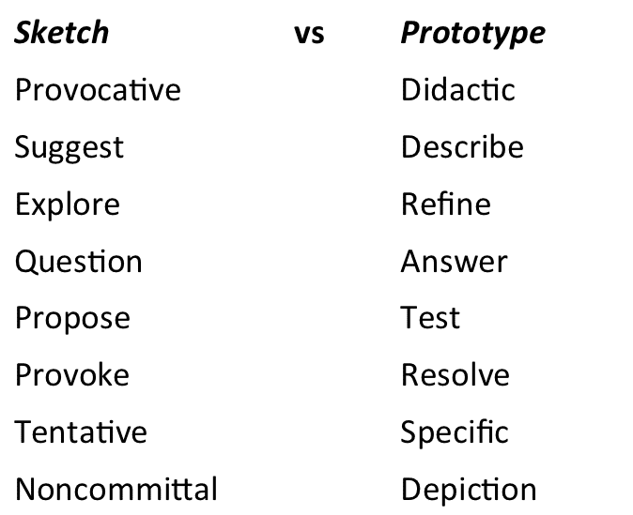
Sketch Vs Prototype (CO3)

Slide 60
Sketches have the following characteristics
SKETCHING (CO3)
Quick: Don’t invest a long period producing them.
Timely: Produce them when and as the need arises.
Disposable: Rely on their usefulness to explore a concept and not on their production costs.
Plentiful: Produce sketches as a collection that explores different aspects of interaction over time.
Minimalist: Use sketches to clarify one concept at a time.

Slide 61
Enhancing Sketches - Annotations, Arrows and Notes
SKETCHING (CO3)
Sketches must rely on the written word to convey their meaning in full. Your sketches and accompanying text must communicate your entire design rationale to you and your team. All the following elements play their part in explaining your sketches and the objects, actions and emotions they represent.
Annotations - These are names, labels and explanations located next to different parts of a sketch to expand and clarify the meaning of any element depicted. Tie annotations to different elements in your sketch using arrows, braces, numbering and spatial proximity. Write your annotations using a different colour that contrasts with the sketch proper.
Arrows - Apart from pointing to specific elements in a sketch, use arrows to illustrate interaction flow, a sequence of events, movement and direction.
Notes - Any text, long or short, that provides additional insight into your sketch is a note. Use notes to:
provide detailed explanation of the action or sequence illustrated
describe an idea derived from an illustration
list unresolved issues
explore design elements not depicted in the sketch
clarify the purpose of each element you present, specially non-static ones
keep a record of your thought process when you first draw a sketch

Slide 62
Sketching Methods
SKETCHING (CO3)
You can also use sketching as a collection method. Use sketching to capture the ideas and/or designs you encounter in your daily activities. Other people’s designs are concrete examples of solutions posed to challenges under different constraints. Add them to your knowledge bank to remix, influence, inspire or steer your own ideas in different and perhaps unexpected and innovative directions. To help you in this process, we introduce below two simple approaches to collecting virtual and real-life designs.
1. Scribble Sketching
The idea behind this sampling technique is to capture, as fast as possible and with the broadest of strokes, the essence of the object, design or action we are trying to preserve. Leave out non-important details, decorations, text and other non-essential elements. Include textual annotations (see previous section) in your scribble sketches to clarify functionality.

Slide 63
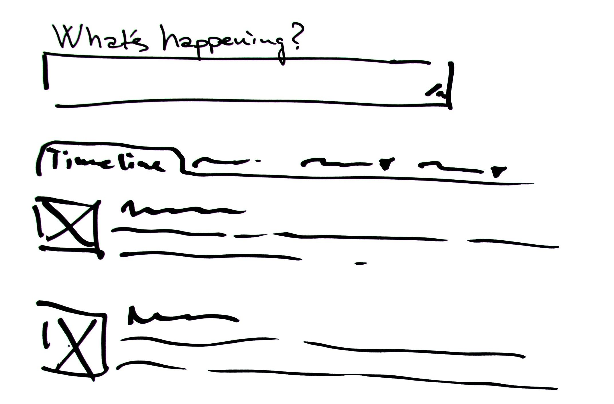
Scribble Sketching
SKETCHING (CO3)

Slide 64
SKETCHING (CO3)
Capture with “broad strokes” the essence of the object, design or action you are trying to preserve.
As a designer, you will find it’s a great idea to make a habit of always carrying a notebook to keep a record of objects, designs and actions that provoke or inspire you. Since you are the main audience of the scribble sketching technique, don’t feel forced to strive for fidelity. You should only provide a level of detail that is good enough to prompt your memory afterwards. Those rough etchings thus become direct touchstones with ideas and also skeletons you can eventually refine into powerful final versions.
2. Sampling with Cameras
The goal of this sampling technique is to use still photos and video to capture some features of the world. You can apply this sampling technique during your weekly grocery shopping, while running your favourite route, on your commute to work, or when you meet friends for dinner. The pervasive nature of smartphones should facilitate this activity. Capture objects, designs and actions that delight, inspire and irritate you.
Record of Failed Design Efforts
Use the two sampling techniques described to keep a record of failed design efforts. Gather objects and situations that annoy you. Write down the reasons behind this negative effect. This exercise will help you develop a critical eye. A critical eye will allow you to identify even the shortcomings of your own work. In doing so, you will develop and show more sophisticated design skills.
Record of Successful Design
You should also use the sampling techniques mentioned to keep a record of successful design. They will help you draw inspiration from multiple domains to ground your design work on features other than those of the digital realm.

Slide 65
Idea Selection Criteria (CO3)
We should ensure that ideas that have made it through Post-it voting and other elimination exercises in the convergence sessions – just described above – are evaluated, based on these selection criteria, and you should rank them according to how they meet these criteria. These idea selection criteria will help you at this stage to provide a guide for choosing ideas which fit well into your goals, your research about your users, their needs, and your insights about them which you’ve condensed into your problem statement—which is also called your Point of View.
Does it fit with people's needs? Is there demand?
Does it really meet the goals set initially?
Does it meet the requirements in our problem statement/Point Of View?
Does it answer our “How Might We” questions in a satisfying way?
Is it different enough from what exists to add additional value?
Do we have access to the budget—enough to implement even partially?
Is the technology available?
Will we be able to roll it out with the available resources?
Can we get approval from decision makers?

Slide 66
How to Select the Best Idea by the end of an Ideation Session
Idea Selection Criteria (CO3)
Once the Ideation session is complete, the ideas must be collected, categorized, refined, and narrowed down, so the team is able to select the best solutions, ideas, and strategies from a shortlist. These methods can help you select the best idea at the end of an Ideation session:
Post-it Voting or Dot Voting.
Four Categories Method
Bingo Selection
Idea Affinity Maps
Now Wow How Matrix
Six Thinking Hats
Lean Startup Machine Idea Validation Board
Idea Selection Criteria

Slide 67
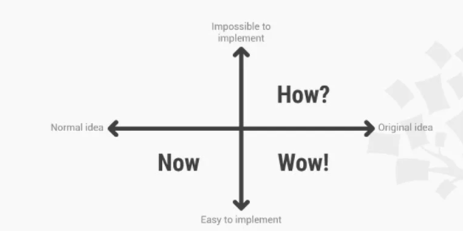
Idea Selection - Now Wow How Matrix
Idea Selection Criteria (CO3)
The Now Wow How Matrix provides a mechanism for evaluating ideas on a scale of:
Now: ideas that can be implemented immediately but which lack novelty.
Wow: ideas that can be implemented and are innovative.
How: ideas that could possibly be implemented in the future.

Slide 68
Now Wow How Matrix
Idea Selection Criteria (CO3)
The Now Wow How Matrix should contain two axes, with the vertical representing difficulty of implementation and the horizontal axis representing the degree of innovation. On the 2 x 2 grid formed, the three categories are located at the bottom left (now), bottom right (wow) and top right (how), with the top left block left blank to represent ideas which are impossible to implement. It provides an easy-to-follow formula for evaluating the viability of ideas as well as their innovativeness. Provide participants with coloured dot stickers, each representing one of the categories, allowing group participants to vote on where they think ideas should be pitched on the scale. You can also develop custom graphs with finer levels of gradation for a broader scale assessment of the many ideas.

Slide 69
Idea Selection – Apply Edward De Bono's Six Thinking Hats
Idea Selection Criteria (CO3)
The Six Thinking Hats Technique provides a range of thinking styles to apply to idea selection. It involves purposely evaluating and considering ideas through various mindsets so as to uncover the widest range of possible angles on the ideas being assessed. It helps break participants out of their set styles of thinking and forces them to look at the ideas being assessed from multiple viewpoints and assessment criteria.
White Hat: The White Hat calls for information which is known or needed. It’s all about this: 'The facts, and nothing but the facts.'
Yellow Hat: The Yellow Hat symbolizes optimism, confidence, and brightness. Under this hat, you explore the positives and probe for value and benefit.
Black Hat: The Black Hat is all about judgement. When you put on this hat, you’re the devil's advocate where you try to figure out what or why something may not work. It’s now your job to spot the difficulties and dangers and ask where things might go wrong. This is probably the most powerful and useful of the hats, but it’s a problem if you overuse it.
Red Hat: The Red Hat calls for feelings, hunches, and intuition. When you use this hat, you should focus on expressing emotions and feelings and share fears, likes, dislikes, loves, and hates.
Green Hat: The Green Hat focuses on creativity: the possibilities, alternatives, and new ideas. It's your opportunity to express new concepts and new insights.
Blue Hat: The Blue Hat is used to manage the thinking process. It's your control mechanism that ensures the Six Thinking Hats guidelines are observed.

Slide 70

Apply Edward De Bono's Six Thinking Hats
Idea Selection Criteria (CO3)
When assessing ideas, we can use the Six Thinking Hats to evaluate them from a range of angles in order to avoid cognitive bias in decision making and to evaluate ideas fairly, based on a holistic outlook.

Slide 71
Converging
Idea Selection Criteria (CO3)
At some point in your ideation session, you’ll have reached a critical mass of ideas, and it will become unproductive to attempt to keep pushing for more. This is different from the natural creative slumps that teams experience throughout ideation sessions, and means it is a good point to stop and focus on pruning. This is referred to as the ‘convergent stage’ where ideas are evaluated, compared, ranked, clustered and even ditched in an attempt to pull together a few great ideas to act on. Hang onto those unused ideas, though; they may prove useful in future ideation sessions as stokers or idea triggers. Right now, the aim is spotting potential winners, or combinations of winning attributes, from a number of ideas.

Slide 72
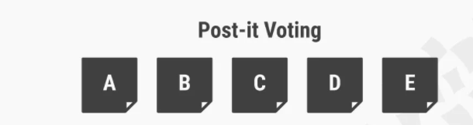
Post-it Voting or Dot Voting
Idea Selection Criteria (CO3)

Slide 73
Post-it Voting or Dot Voting Cont…
Idea Selection Criteria (CO3)
Best practice:
You write all of the ideas which have been generated in the ideation session down on individual Post-its.
Then you give all participants a number of votes (around three to four should do) to choose and write down their personal favourite ideas.
Participants vote by using stickers or simply using a marker to make a dot on the ideas they like.
You can also use variations in colour in order to let participants vote on which ideas they like the most or which they dislike the most.
You can invent other voting attributes when it makes sense.
This process allows every member to have an equal say in the shortlisted ideas.

Slide 74
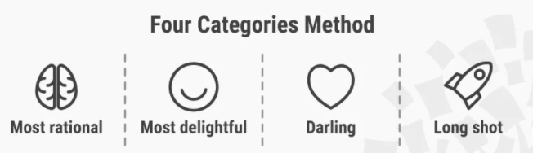
Four Categories Method
Idea Selection Criteria (CO3)
The Four Categories method entails dividing ideas according to their relative abstractness, ranging from the most rational choice to the 'long shot'. The four categories are: the rational choice, the most likely to delight, the darling, and the long shot.
Best practice: Ideation participants decide upon one or two ideas for each of these categories. This method ensures that the team covers all grounds, from the most practical to the ideas with the most potential to deliver innovative solutions.

Slide 75
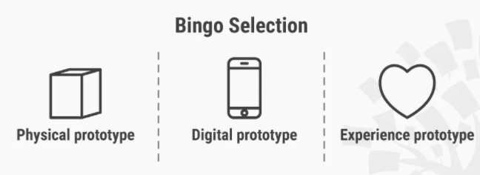
Bingo Selection
Idea Selection Criteria (CO3)
Best practice: Similarly, the Bingo Selection method inspires participants to divide ideas. However, in this method, the facilitator should encourage the participants to split ideas according to a variety of form factors, such as their potential applications in a physical prototype, a digital prototype, and an experience prototype.

Slide 76
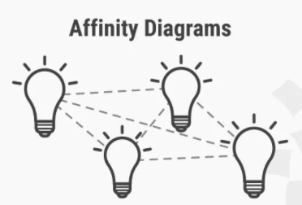
Idea Affinity Diagrams
Idea Selection Criteria (CO3)
Use affinity diagrams or similar activities to cluster similar ideas together and make connections between them that will help you uncover patterns or themes that may be promising.
Best practice: Paste up all the ideas which you’ve collected in your ideation sessions—and then, as a group, make sense of these by clustering ideas which share attributes, eliminate duplicates, and form idea themes or concept themes. This will help you in the process of selecting the best ideas or idea themes.

Slide 77
Lean Startup Machine Idea Validation Board
Idea Selection Criteria (CO3)
Lean methodologies—with their roots in Toyota's production system—are making their way into every sector due to their light footprint and potential to speed up decision-making and project cycles dramatically. The crux of the methodology centres on testing assumptions as early as possible in order to avoid venturing too far down the wrong paths. The Lean Startup Machine is a three-day intensive series of workshops by Trevor Owens, which emerged out of the movement instigated by Eric Ries' book Lean Startup. The Lean Startup Machine Validation Board is a tool which enables validation of ideas based on the lean startup methodology.
The premise of this approach is starting off with set of related hypotheses:
Customer Hypothesis
Problem Hypothesis
Solution Hypothesis
We interrogate and test these three related hypotheses. If we cannot validate them, we pivot on them so as to move towards a more valid set of hypotheses that will help build an innovation foundation, one which is viable and addresses a real need.

Slide 78
Project Cycle Example
Idea Selection Criteria (CO3)
Google ventures 5-day design sprints series details their process of rapidly assessing new opportunity areas, generating ideas, selecting those ideas and then testing them. Their Day 2: Diverge and Day 3: Decide serve as illustrations of how ideations' divergent and convergent phases play themselves out in a technology startup environment.

Slide 79
What to Do With the Winning Ideas?
Idea Selection Criteria (CO3)
With a series of ideas (3rd stage in the Design Thinking process) ready to be prototyped (4th stage in the Design Thinking process) for further testing (5th stage in the Design Thinking process) and validation, you're ready to move on these next stages of the Design Thinking journey. Make sure you have significantly different ideas that make it to the last few so that you can test and explore a few different routes to a winner. Ideas that are very similar can be batch prototyped, with some variation in prototype iterations

Slide 80
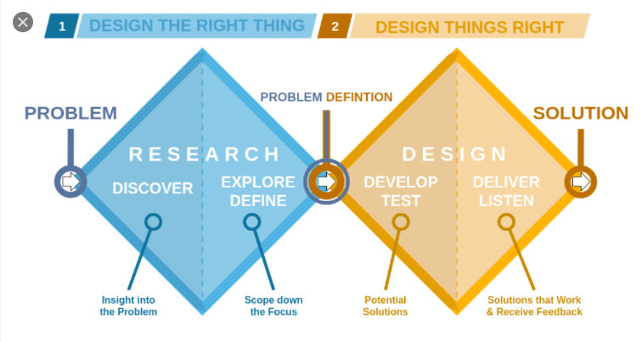
Double Diamond Approach (CO3)

Slide 81
Double Diamond Approach (CO3)
Double Diamond is the name of a design process model popularized by the British Design Council in 2005, and adapted from the divergence-convergence model proposed in 1996 by Hungarian-American linguist Béla H. Bánáthy.The two diamonds represent a process of exploring an issue more widely or deeply (divergent thinking) and then taking focused action (convergent thinking). It suggests that the design process should have four phases:
Discover: Understand, rather than simply assume, what the problem is. It involves speaking to and spending time with people who are affected by the issues.
Define: The insight gathered from the discovery phase can help to define the challenge in a different way.
Develop: Give different answers to the clearly defined problem, seeking inspiration from elsewhere and co-designing with a range of different people.
Deliver: Involves testing out different solutions at small-scale, rejecting those that will not work and improving the ones that will.

Slide 82
Double Diamond Approach (CO3)
Phases of this process are either diverging or converging. During a diverging phase, you try to open up as much as possible without limiting yourself, whereas a converging phase focuses on condensing and narrowing your findings or ideas.
If you google the Double Diamond you are bound to find various interpretations and also varying wordings. I am going to stick to the version above as its wording allows flexibility and agility in its application in my opinion. Or in other words, it is the most appealing recipe to me.
The four phases of the Double Diamond may be simplified and merged into two main stages of the process.

Slide 83
Double Diamond Approach (CO3)
Stage 1 — Doing the right thing (Diamond 1 — Discover and Define) Whatever you do, you ought to look for the right problem to solve or the right question to ask before you try to do so. This is all about what you do.
Stage 2 — Doing things right (Diamond 2 — Develop and Deliver) Once you have found the right question to answer or the right problem to solve, you want to make sure that you do this the right way. This is all about how you do it.

Slide 84
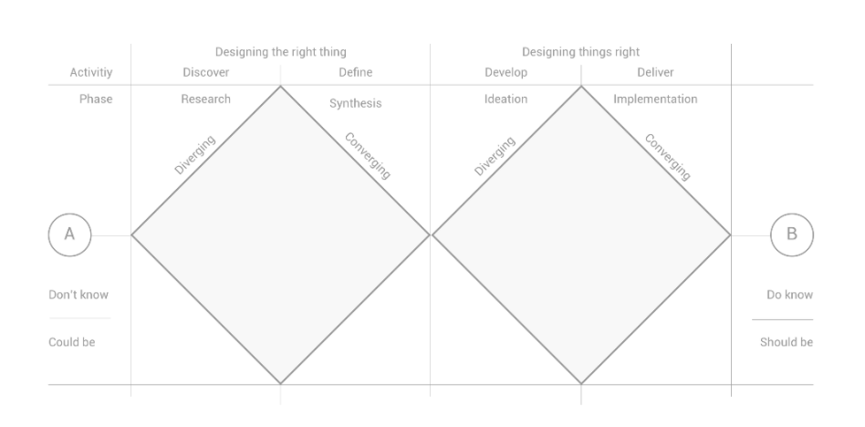
Double Diamond Approach (CO3)

Slide 85
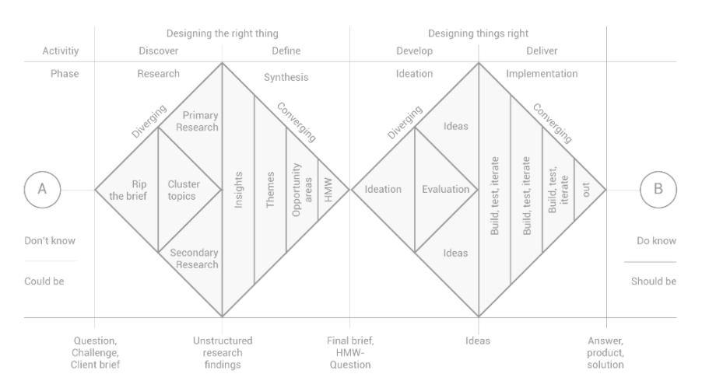
Double Diamond Approach (CO3)

Slide 86
Stage 1 — Doing the right thing (Diamond 1 — Discover and Define)
Double Diamond Approach (CO3)
The following paragraphs provide you with a step-to-step approach for each phase.
Stage 1 — Doing the right thing (Diamond 1 — Discover and Define)
This phase is split into Discover/Research and Define/Synthesis.
Discover / Research
Rip the brief (the usual starting point of your challenge) — Try to question the brief or your initial question by challenging every part of it and evaluating fields of interests. List as many elements as you can, find characteristics, define areas of interest and extremes, list places, people (personas), experiences that are related and can be explored.
Before you dive into your research, cluster your findings into topics to get an overview and you might have to limit yourself in terms of the scope you want to research.
Dive into your research. Apply primary (field) and secondary (desk) research methods.
As a result, you ought to end up with a huge pile of unstructured research findings.

Slide 87
Stage 1 — Doing the right thing (Diamond 1 — Discover and Define) cont….
Double Diamond Approach (CO3)
Define / Synthesis
In order to make sense of your findings, you want to synthesise your research by applying the following steps:
Download (summarise your raw findings and share them with your team) all your research.
Cluster learnings and similarities to themes.
Find insights (insights are the dormant truth about the consumer’s motivations, wishes or frustrations regarding a specific topic) build opportunity areas (a phrasing of the potential area of action).
Create HMW questions (A so called “how might we...” question that makes a tangible statement of what is to be done or solved within the area of action).
As a result, you ought to come up with a revamped brief (final brief, HMW-question) that either clarifies or details the initial brief challenge or even contradicts it.

Slide 88
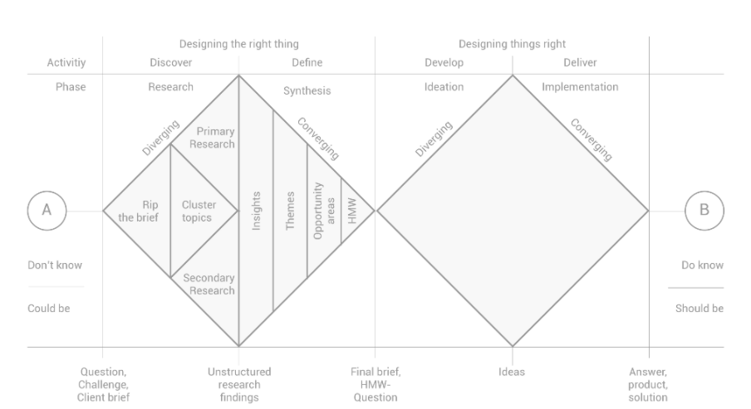
Stage 1 — Doing the right thing (Diamond 1 — Discover and Define) Cont…
Double Diamond Approach (CO3)

Slide 89
Stage 2 — Doing things right (Diamond 2 — Develop and Deliver
Double Diamond Approach (CO3)
Stage 2 — Doing things right (Diamond 2 — Develop and Deliver)
This phase is split into Develop/Ideation and Deliver/Implementation.
Develop / Ideation
As you have deduced the actual question to solve or challenge, you start ideating.
Ideation This is the fun part and as it is part of a diverging phase. You should restrain from limiting yourself and approach ideation with an open mind. Do not judge during ideation. Apply a “yes, and…” rather than a “no…” or “yes, but…” mentality. Let anything happen at this point and build upon each other’s ideas. There are tonnes of creative ideation tools and methods out there. I am not going into detail here.
Evaluation Towards the end of an ideation phase, evaluate your ideas and select your favourite ones. Two tools that come in handy are dot-votings (each team member votes for ideas) or impact/feasibility matrices (a matrix that puts feasibility in relation to a potential impact of an idea).
As a result, you ought to end up with one or a small number of ideas you want to later prototype and test, in order to find the best answer or solution to your initial question or problem.

Slide 90
Stage 2 — Doing things right (Diamond 2 — Develop and Deliver cont…
Double Diamond Approach (CO3)
Deliver / Implementation
Once you have come up with potential solutions (set of ideas), you want to evaluate the final one and the way it needs to be implemented or executed. In order to so, you may apply an agile approach consisting of three steps:
Build/Prototype
Test/Analyse
Iterate/Repeat
Aim for MVPs — minimum viable products/prototypes, that offer enough tangibility to find out whether they solve the initial problem or answers the initial question.
As a result, you ought to be able to go “out” with your final proposal, product, answer or solution.
Once you have done so you might go back to start and do it all over again because there are always things to be improved.

Slide 91
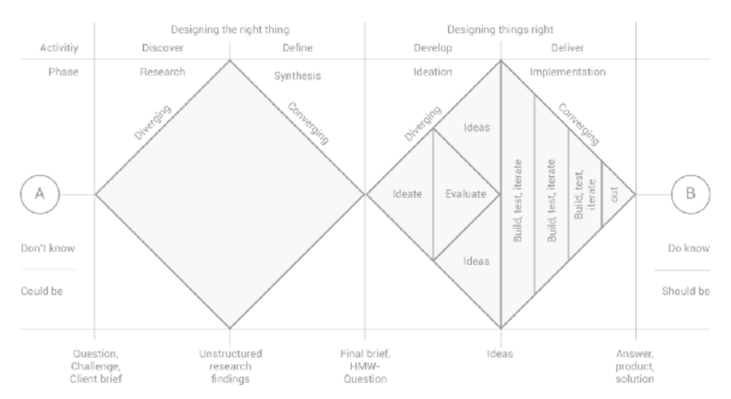
Stage 2 — Doing things right (Diamond 2 — Develop and Deliver cont…
Double Diamond Approach (CO3)

Slide 92
Presenting ideas
Presenting ideas (CO3)
The Most Essential Ideation Techniques: Which Ideation Techniques Should You Choose?
Due to the nature of ideation, it is extremely important to make use of techniques that match the type of ideas you're trying to generate. The techniques you choose will also need to match the needs of the ideation team, their states of creative productivity and their experience in ideation sessions. Here is an overview of the most essential ideation techniques:
Brainstorm
During a Brainstorm session, you leverage the synergy of the group to reach new ideas by building on others’ ideas. Ideas are blended to create one good idea as indicated by the slogan “1+1=3”. Participants should be able to discuss their ideas freely without fear of criticism. You should create an environment where all participants embrace wild ideas and misunderstanding, and which will allow you to reach further than you could by simply thinking logically about a problem.

Slide 93
Presenting ideas cont….
Presenting ideas (CO3)
Braindump
Braindump is very similar to Brainstorm, however it’s done individually. The participants write down their ideas on post-it notes and share their ideas later with the group.
Brainwrite
Brainwriting is also very similar to a Brainstorm session. However, the participants write down their ideas on paper and, after a few minutes, they pass on their own piece of paper to another participant who’ll then elaborate on the first person’s ideas and so forth. Another few minutes later, the individual participants will again pass their papers on to someone else and so the process continues. After about 15 minutes, you will collect the papers and post them for instant discussion.
Brainwalk
Brainwalk is similar to Brainwriting. However, instead of passing around the paper, the participants walk around in the room and continuously find new “ideation stations” where they can elaborate on other participants’ ideas.

Slide 94
IDEATION (CO3)
Ideation is the process where you generate ideas and solutions through sessions such as Sketching, Prototyping, Brainstorming, Brainwriting, Worst Possible Idea, and a wealth of other ideation techniques. Ideation is also the third stage in the Design Thinking process. Participants gather with open minds to produce as many ideas as they can to address a problem statement in a facilitated, judgment-free environment.
Ideation process is characterized by the alternation of divergent and convergent thinking, typical of design thinking process.
To achieve divergent thinking, it may be important to have a diverse group of people involved in the process. Design teams typically begin with a structured brainstorming process of "thinking outside the box." Convergent thinking, on the other hand, aims for zooming and focusing on the different proposals to select the best choice, which permits continuation of the design thinking process to achieve the final goals.
Notes:
After collecting and sorting many ideas, a team goes through a process of pattern finding and synthesis in which it has to translate ideas into insights that can lead to solutions or opportunities for change. These might be either visions of new product offerings, or choices among various ways of creating new experiences.

Slide 95
IDEATION (CO3)
Ask the right questions and innovate with a strong focus on your users, their needs, and your insights about them.
Step beyond the obvious solutions and therefore increase the innovation potential of your solution.
Bring together perspectives and strengths of your team members.
Uncover unexpected areas of innovation.
Create volume and variety in your innovation options.
Get obvious solutions out of your heads, and drive your team beyond them.
Ideation Will Help You:

Slide 96
IDEATION (CO3)
Characteristics Required for Successful Ideation
Ideation requires purposefully adopting certain characteristics, whether they are natural or whether they need to be encouraged and learnt. Regardless of one's personality or way of thinking, we all fall into the trap of sticking to patterns and familiar ground, and tend to use the same recipes for solving problems, as this reduces the cognitive load required. Experts and novices alike need to be constantly self-aware and purposely intend to adopt some of the following characteristics, which create an open mind and fertile ground for sparking unconventional ideas.

Slide 97
Characteristics Required for Successful Ideation
IDEATION (CO3)
Adapting: Be able to switch how you see, understand, and extend thinking as new input gets generated.
Connecting: Be able to connect seemingly unrelated concepts, attributes or themes in order to create new possibilities.
Disrupting: Be able to overturn commonly held beliefs, assumptions or norms in order to re-think conventional approaches.
Flipping: Turn dead-ends or deadlocks into opportunities by flipping them over or rapidly changing direction towards greater viability.
Dreaming and Imagining: Be able to visualise a new picture of reality by turning abstract needs into tangible pictures or stories, thereby allowing the space required for inventing bridges to that reality.
Experimental: Be open and curious enough to explore possibilities and take risks; be willing and eager to test out ideas and eager to venture into the unknown.
Recognise Patterns: Seek to spot common threads of meaning, and ways of seeing, doing and behaving; be able to recognise attributes or shared values across a spectrum of influence and input; and finally be able to utilize these commonalities to build solutions.
Curiosity: Be willing to ask uncomfortable, silly or even crazy questions. Be willing to explore and experience, in order to understand and learn something new and different.

Slide 98
Five Themes Of Design Thinking (CO3)
Design Thinking is a tricky concept to define. Depending on who you ask, it’s either a process, a framework, a state of mind, or some combination of all of these.
Considering this ambiguity and the difficulty it presents design thinking researchers, Carlgren, Rauth & Elmquist (2016) attempted to pin down a useful definition of design thinking that can be applied in research projects going forward. What they discovered is useful not only to this end, but also for practitioners currently looking to apply design thinking for social innovation.

Slide 99
After a comprehensive review of the extant literature on design thinking*, Carlgren, Rauth & Elmquist (2016) were able to identify five themes of characteristic of design thinking. These themes arose from analysis of design thinking procedures in six companies of various sizes that self-identified as practitioners of design thinking. The themes generally align with the previous research in the field, though similar concepts were bunched under one broader theme for clarity. The five characteristic themes follow, along with thoughts about how they might be applied in a sport for development program:
Five Themes Of Design Thinking (CO3)

Slide 100
Five Themes Of Design Thinking (CO3)
User Focus
The needs of the end user not only need to be considered with empathy and understanding, but the users themselves should also be involved in the design thinking process.
In a sport for development context this would mean including the athletes themselves – including current athletes and alumni who have gone through the program and have the benefit of hindsight to help them identify improvements that might be made.
Problem Framing
Rather than attempting to ‘isolate’ the problem, the scope of the problem should instead be expanded to ensure no possible solutions are missed.
The “problem” with a sport for development program may not even look like a problem at all. It may be a case of fixing what “ain’t broke” in order to improve facets of the program across the board. Rather than waiting for complaints to arise, it’s about looking around and asking ourselves: “how can we do better?”

Slide 101
Five Themes Of Design Thinking (CO3)
Visualization
Use either graphical or physical representations of proposed solutions (products) in a rapid prototyping process that involves frequent failure in order to succeed more meaningfully.
Prototyping is an especially powerful tool for sport for development programs and may include role playing in order to better understand the challenges being faced by different stakeholders.
Experimentation
This is the process of moving through iterations of the design and not being afraid to revisit previous iterations if the current one isn’t satisfactory.
As you work through your prototypes, don’t be discouraged if you hit a snag. Simply take a step back to what you know was working and begin anew the search for additional value.

Slide 102
Five Themes Of Design Thinking (CO3)
Diversity
Members of the design thinking team should have different skills, experience, interests, and personalities.
This is rather simple to accomplish in a sport for development program, as stakeholders typically bring all of these brands of diversity to the table without the need to specifically seek it out. Parents, volunteers and participants will all bring something unique to the design thinking process, but it’s not necessary to stop there.
Flexibility Is Key
Interestingly (and yet consistent with the varied nature of conceptualisations of design thinking seen in the academic and popular literature), each company engaged with each of these five themes in the design thinking processes but with different prioritizations of one or more themes over others. Clearly, the themes are adaptable across myriad contexts.
Such a flexible framework is sure to hold value for the design of your own sport for development program. I’d love to hear how you go with applying any of the above – please don’t hesitate to use the contact form to reach out.

Slide 103
How to write a meaningful problem statement
Problem Statement (CO3)
Writing a meaningful problem statement can be extremely challenging. How do you condense all the complexities of the user’s conscious and unconscious desires into one simple, actionable statement? Fortunately, there are some tried-and-tested methods that will help you do just that.

Slide 104
The four Ws
Problem Statement (CO3)
Asking the right questions will help you put your finger on the right problem statement. With all your findings from the empathize phase in one place, ask yourself the four Ws: Who, what, where, and why?
Who is experiencing the problem? In other words, who is your target user; who will be the focus of your problem statement?
What is the problem? Based on the observations you made during the empathize phase, what are the problems and pain-points that frequently came up? What task is the user trying to accomplish, and what’s standing in their way?

Slide 105
The four Ws
Problem Statement (CO3)
Where does the problem present itself? In what space (physical or digital), situation or context is the user when they face this problem? Are there any other people involved?
Why does it matter? Why is it important that this problem be solved? What value would a solution bring to the user, and to the business?
Approaching your observations with these four questions in mind will help you to identify patterns within your user research. In identifying the most prevalent issues, you’ll be one step closer to formulating a meaningful problem statement.

Slide 106
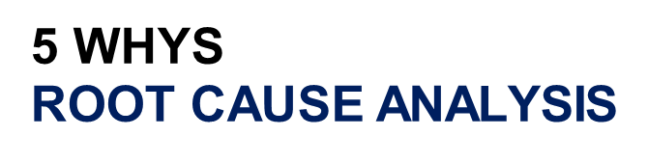
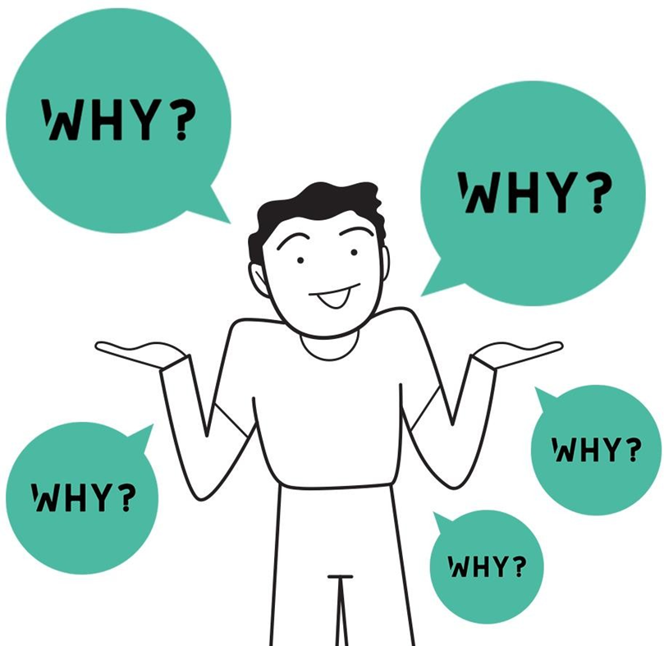
5 WHYS
Problem Statement (CO3)

Slide 107
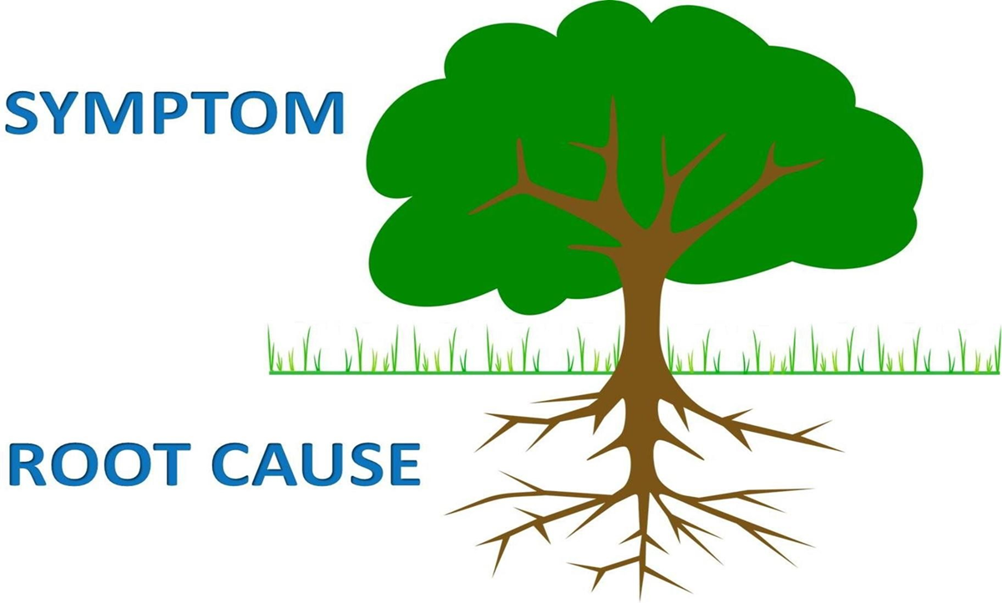
Problem Statement (CO3)

Slide 108
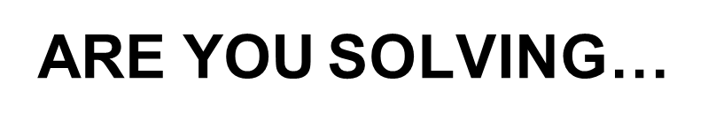
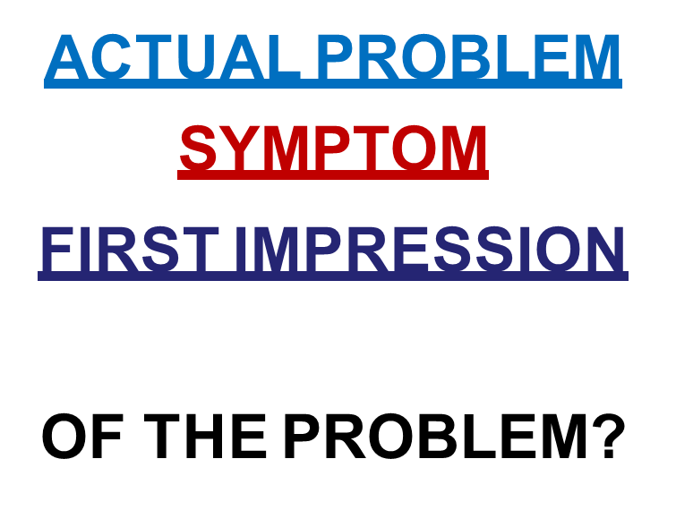
Problem Statement (CO3)

Slide 109


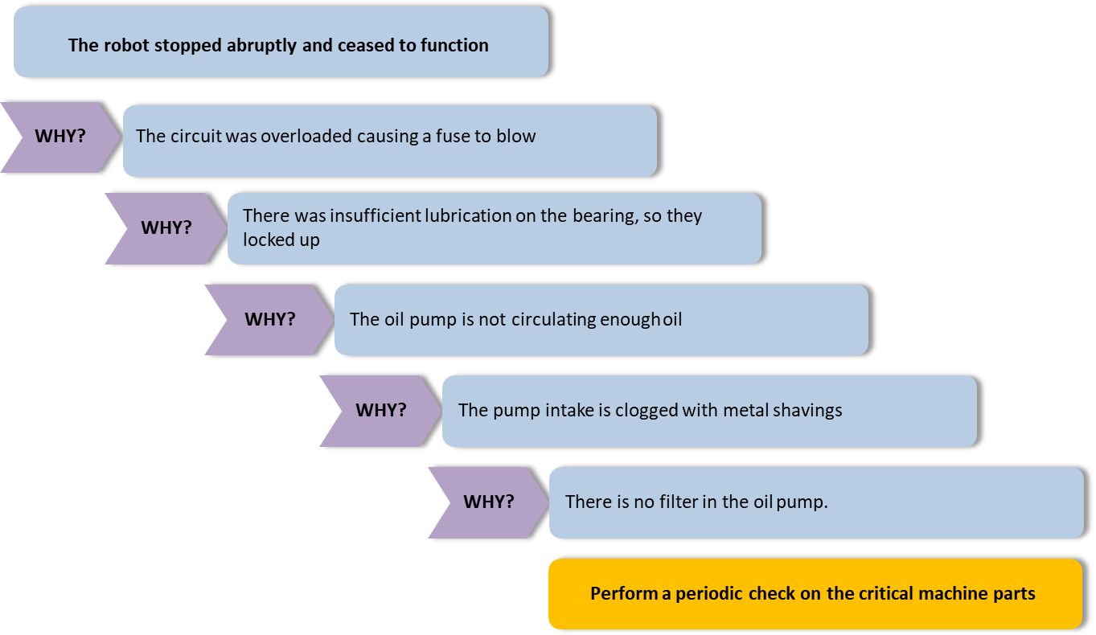
Problem Statement (CO3)

Slide 110
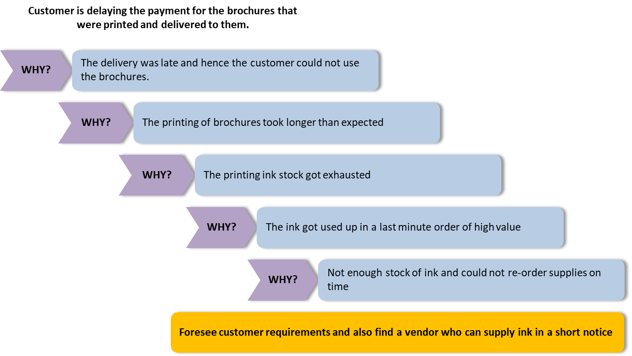
Problem Statement (CO3)

Slide 111
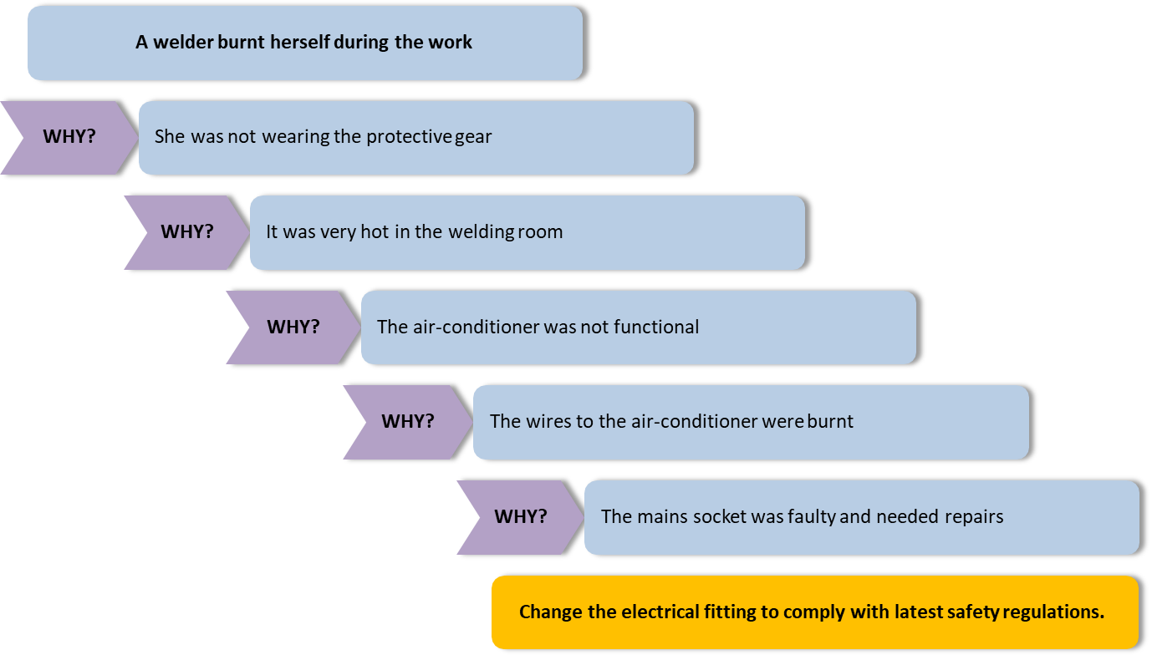
Problem Statement (CO3)

Slide 112
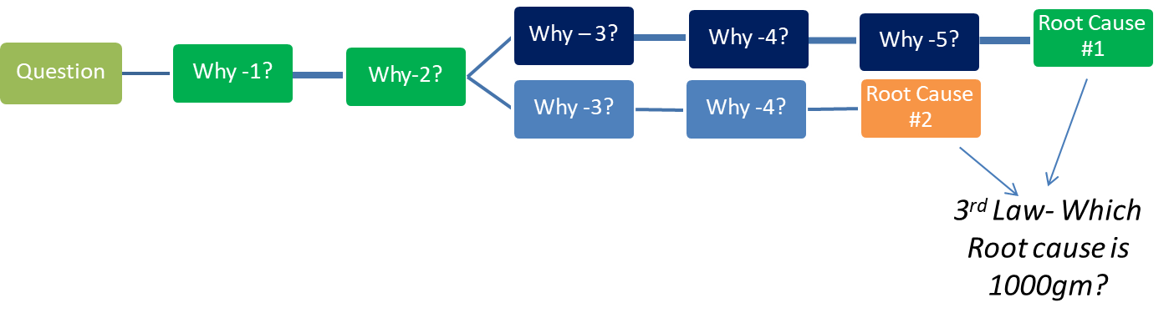
Problem Statement (CO3)
Important:5-WHYs

Slide 113

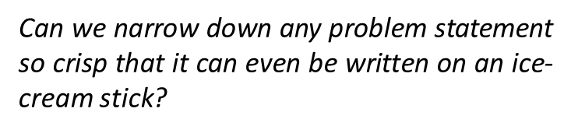
Problem Statement (CO3)
THE ICE CREAM STICK CHALLENGE

Slide 114
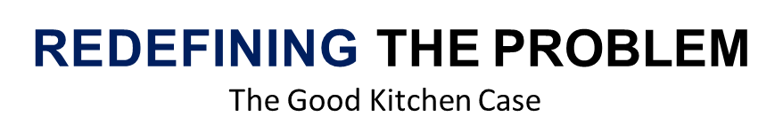
Problem Statement (CO3)

Slide 115

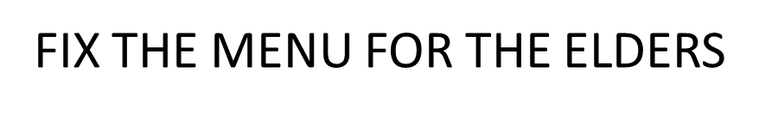
Problem Statement (CO3)

Slide 116
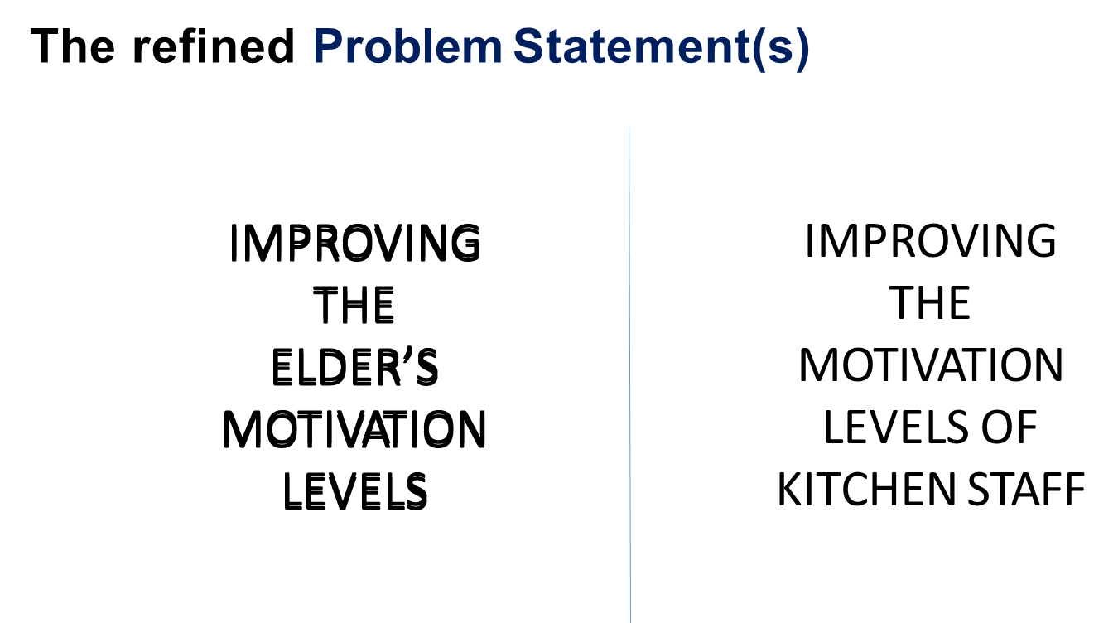
Problem Statement (CO3)

Slide 117
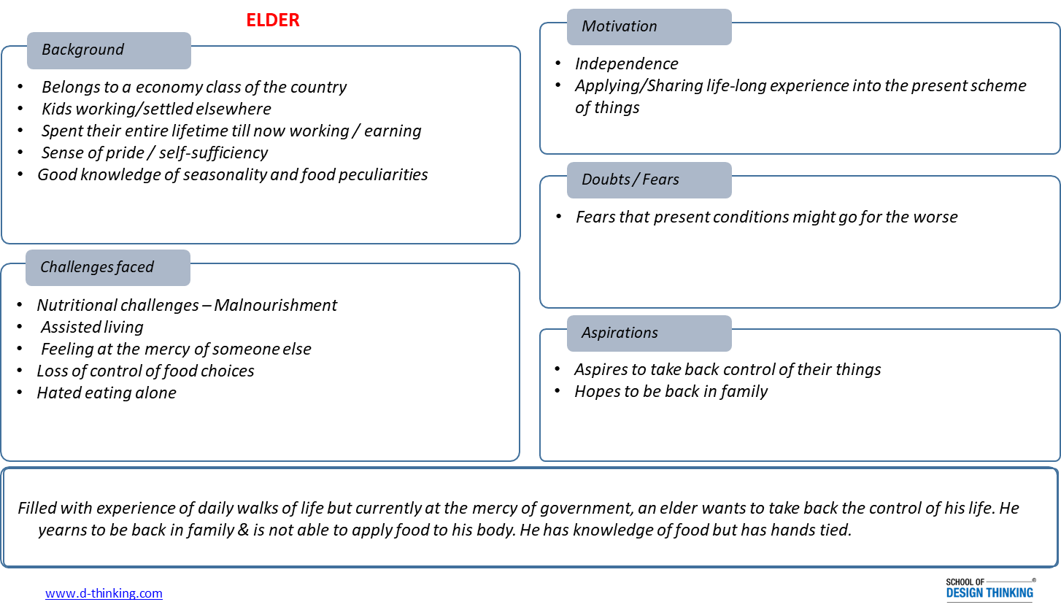
Persona Mapping (CO3)

Slide 118
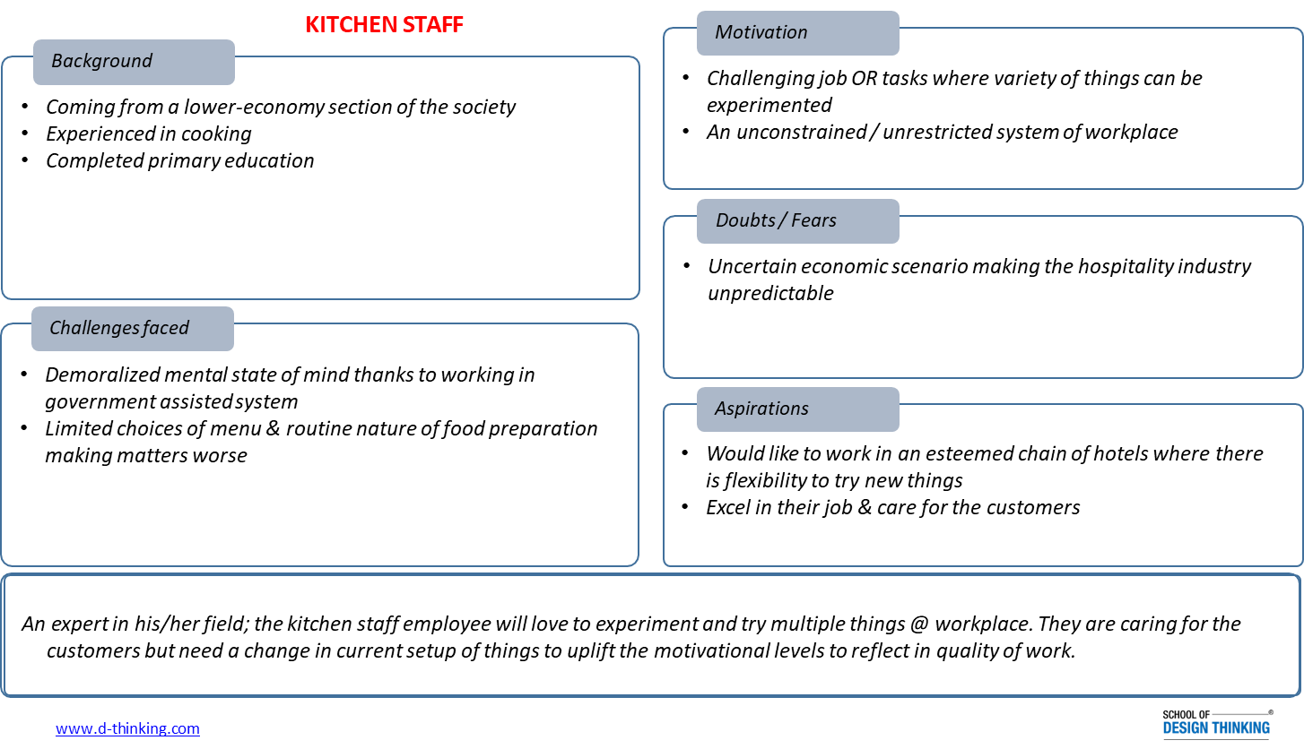
Persona Mapping (CO3)

Slide 119
Metaphor (CO3)
As described by designer Dan Saffer:
“Metaphor can be a powerful tool for designers, in both the process of designing and within the products themselves…Metaphors provide cues to users how to understand products: to orient and personify.”
Metaphors help designers to understand unfamiliar design problems by juxtaposing them with known situations. Retrieving concepts from metaphors demands creative thinking. While the importance of this heuristic has been acknowledged in design, more research is needed to appreciate its contribution to design practice.

Slide 120
Metaphor (CO3)
Metaphors can be a powerful tool for improving the user experience
Metaphors can:
explain abstract or complex concepts
create a sense of familiarity
trigger emotions
draw attention to your site or certain components of it
motivate users to take action

Slide 121
Metaphor (CO3)
Metaphors are a great tool to help users understand abstract or unfamiliar content. By linking abstract information to a concrete concept, it becomes easier for people to understand the information.
The most basic and common use of metaphors on the Web: Icons. These little symbols help users grasp a concept quickly. Icons usually refer to something that we know from the physical world and that we can somehow relate to an abstract concept on the Web.
For example, on the site Startups, This Is How Design Works, you can see how a light bulb icon is used to denote the word “innovation”, a wrench icon to refer to making a product useful (utility), and a paintbrush icon to represent the word “aesthetic”:

Slide 122
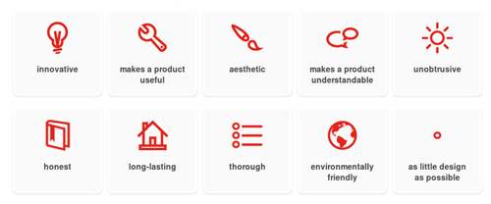
Metaphor (CO3)

Slide 123
RANDOM ASSOCIATION TECHNIQUE (CO3)
State the problem to solve
Gather random stimuli (Dictionary, Word List )
Create associations between a chosen random word, your challenge
The mind loves to make connections
4. Increase the Associations :
Contiguity (A saddle may remind you of a horse, a tree of a forest, a foot of a shoe)
Similarity (A cat could remind you of a tiger, the human eye is similar to a camera, a stair is similar to an escalator)
Contrast (A dwarf may trigger associations of a giant, day is a contrast to night, a sad face is a contrast to a happy face)

Slide 124
MCQ s
Aravind Eye Care System (AECS), an Indian eye care provider for millions of low income people has been using design thinking in its approach since a long time. Which of the below statements are examples of design thinking at AECS?
AECS provides buses from remote locations to the AEC centre to provide transportation to its users, the poor people as they can't afford these
AECS has developed a manufacturing facility which enables providing lenses at a fraction of cost than the market price
AECS has been using telemedicine trucks to enable expert advice of doctors at hospital
All of the above
Which of the following statements is false regarding stakeholders?
Stakeholders may have a positive or negative interest in the success of the project
All stakeholders should be identified before the project execution begins
Stakeholders may not be affected by the outcome but may perceive that they could be affected by the outcome
Stakeholders may be people, or organizations

Slide 125
Faculty Video Links, Youtube & NPTEL Video Links and Online Courses Details
Ideation https://www.youtube.com/watch?v=xXsHI_VlhmY https://www.youtube.com/watch?v=zbLxs6te5to
Double diamond approach https://www.youtube.com/watch?v=HCF1EwdPktg https://sidlaurea.com/2014/09/28/transfer-your-business-through-design-thinking/
5 Why’s https://www.mindtools.com/pages/article/newTMC_5W.htm https://lifedesignlog.com/the-5-whys-activity-for-life-design/

Slide 126
Expected Questions for University Exam
Apply the ideation tool to draw the process of making a cup of tea.
Pollution has increased. Employments have also increased. Number of vehicles have increased. We can’t stop using vehicles. Form 20 HMW questions with regard to this problem.
A school needs focussed tablets to be given to its pupils. Give general steps of design thinking for this
Apply the HMW on Question an assumption: HMW entirely remove the wait time at the airport?

Slide 127
Weekly Assignment
Imagine a situation. There are too many holidays. It becomes difficult to give lectures for complete syllabus. Form 20 HMW questions as to how to see that probability of preparation of students for knowledge and examination does not reduce
A school needs focused tablets to be given to its pupils. Give general steps of design thinking for this.
Apply the How Might We methodology on Sustainable Cities and Communities

Slide 128
Lecture

Slide 129
Recap

Slide 130
Topic Outcome
After completion of these topics, students will be able to-
Understand Mind-mapping process and tools used

Slide 131
MIND-MAP (CO3)
Great tool for ideating & getting unstuck
Simple free association of words, one after another, to open up idea space
Being visual, generates lots of ideas by bypassing the inner logic / verbal sensor

Slide 132
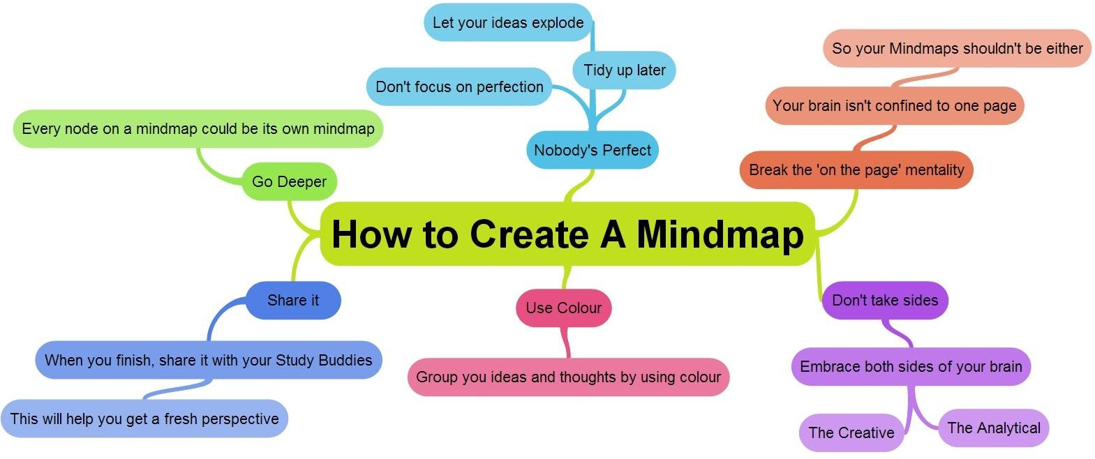
MIND-MAP (CO3)

Slide 133
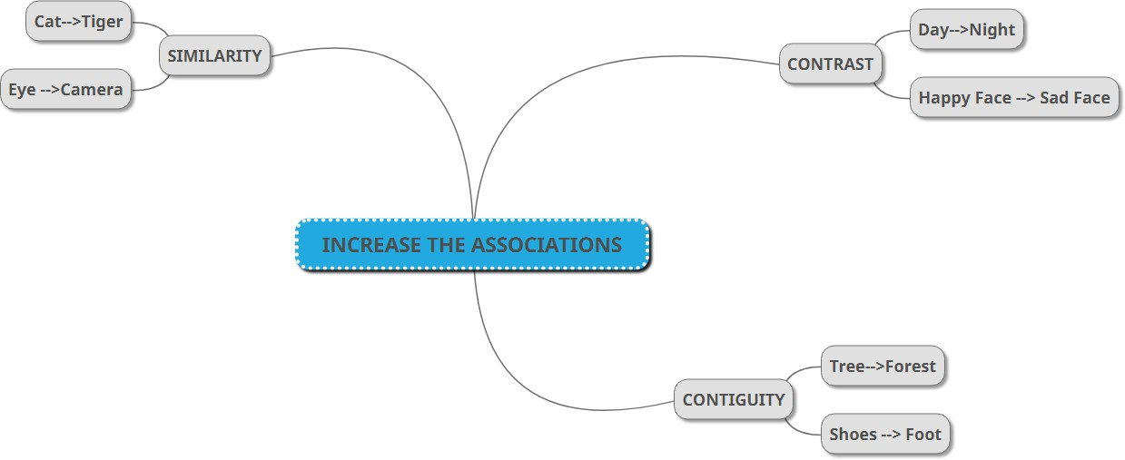
MIND-MAP (CO3)

Slide 134

MIND-MAP (CO3)

Slide 135

How Might We (CO3)
Every problem is an opportunity for design

Slide 136

How Might We (CO3)
Challenges means opportunities in disguise. By framing your challenge as a How Might We question, you’ll set yourself up for an innovative solution.

Slide 137
Steps to conduct a “How Might We” exercise
How Might We (CO3)
Outline insights / painpoints in the current or new initiative
Reframe these insights / painpoints into questions by starting with “HMW”
Write multiple “HMW” questions which create more opportunities for solution exploration
“HMW” questions should not be broad or narrow.

Slide 138
How Might We (CO3)
Which one of the below one is a well framed “How Might We” Question?
a) How might we design the world’s most innovative banking app?
b) How might we design a product that helps users deposit their paycheques in three easy steps by using a guided workflow?
c) How might we design a product that makes our users feel confident and secure during their online financial transactions?

Slide 139
Activity time
How Might We (CO3)
As a Design Consultant, you are supposed to provide an airport-centric experience . You will agree “How might we redesign travel?” or “How might we create the perfect airplane seatbelt using plastic bottles” could be thought of as too broad or too specific. If so, how will you address the above requirement?
Few examples might tickle your creative juices to flow
HMW make the wait the most exciting part of the trip?
HMW entirely remove the wait time at the airport?
HMW make the airport like a spa? Like a playground?
HMW use the kids’ energy to entertain fellow passengers?

Slide 140

Inspiration is Everywhere
How Might We (CO3)
Ideas book
Collection of Photos, sketches, scribbled ideas
Latest trends
Films, TV, Magazines
Creative disciplines
Painting, sculpture, music, architecture
Other areas
Art galleries, museums, libraries, bookshops and supermarkets

Slide 141
Ideation Activity Games

Slide 142
Topic Outcome
After completion of these topics, students will be able to-
Use Six Thinking hats and Million dollar idea Ideation Tools to refine Idea
Use modern tools for Design Thinking process

Slide 143
SIX THINKING HATS (CO3)
The Six Thinking Hats is a role-playing model presented by Edward de Bono in 1986.
It serves as a team-based problem solving and brainstorming technique that can be used to explore problems and solutions and uncover ideas and options that might otherwise be overlooked by a homogeneously thinking group.
Team members can learn how to separate thinking into six clear functions and roles.
Each thinking role is identified with a colored symbolic “thinking hat.” By mentally wearing and switching “hats,” you can easily focus or redirect thoughts, the conversation, or the meeting.

Slide 144
SIX THINKING HATS (CO3)
The White Hat calls for information known or needed. “The facts, just the facts.”
The Yellow Hat symbolizes brightness and optimism. Under this hat you explore the positives and probe for value and benefit.
The Black Hat is for Risks, difficulties, Problems – The risk management Hat, probably the most powerful Hat; a problem however if overused; spot difficulties where things might go wrong, why something may not work, inherently an action hat with the intent to point out issues of risk with intent to overcome them.
The Red Hat signifies feelings, hunches and intuition. When using this hat you can express emotions and feelings and share fears, likes, dislikes, loves, and hates.
The Green Hat focuses on creativity; the possibilities, alternatives, and new ideas. It’s an opportunity to express new concepts and new perceptions.
The Blue Hat is used to manage the thinking process. It’s the control mechanism that ensures the Six Thinking Hats® guidelines are observed.

Slide 145

Blue Hat
SIX THINKING HATS (CO3)
Blue hats concentrate on controlling a process. You wear this hat when leading a team meeting or MCing an event. This is probably why blue hats are compared to movie directors (or project managers!) responsible for making multiple moving parts work in unison. They ask themselves questions like:
What problem are we facing?
What are the desired outcome?
What will solving this problem achieve?
What is the most effective method of proceeding?

Slide 146
Blue Hat
SIX THINKING HATS (CO3)
The blue hat manages the thinking process during group sessions, allowing for greater harmony between the thought patterns of the other thinking hats. After defining the problem, they manage the flow, adoption, and implementation of ideas by:
Setting an agenda
Defining processes and objectives that drive the thinking process forward
Collating all the ideas, opinions, and information presented by the other thinking hats
Structuring an action plan for solving the problem

Slide 147
Blue Hat : Example
SIX THINKING HATS (CO3)
As a project manager, I wear this hat more than any other. Whenever a meeting is called, I spend time beforehand defining the problem (the client has changed their mind about the website color scheme midway through the timeline) and identifying the desired outcome (either a deadline extension or client approval to increase the budget so we can get the extra staff needed to finish on time).
After assembling everyone’s ideas, I create an action plan that I can bring to the client.

Slide 148
White Hat
SIX THINKING HATS (CO3)
White hat thinkers focus on the information available. This includes hard data like verified facts and figures and soft data like feelings and opinions. They use everything to analyze past trends and learn from them. Common questions include:
What information is available right now?
What do we need and what is missing?
How are we going to get any needed or missing information?

Slide 149
White Hat
SIX THINKING HATS (CO3)
When you’re wearing a white hat, you’re not in idea-generating mode, although you can report on ideas that others suggest. If this mindset had a catchphrase, it would be “Just the facts, ma’am!”
White hats are great at the beginning of a session because they approach from an informed perspective. They also do an effective wrap-up job using all the data brought to the table and accumulated while negotiations were in progress.

Slide 150
White Hat : Example
SIX THINKING HATS (CO3)
When my team is in white-hat mode, we only discuss and share the facts and information about the problem. There’s no development in the thinking process itself, only information sharing. We confirm that the client has changed their mind about the color scheme of their website, which will either extend the deadline by a week or cost an extra $600 to bring in the talent needed to complete the work on time.

Slide 151
Yellow Hat
SIX THINKING HATS (CO3)
Yellow hats are fun to be around because they are perpetual optimists. They are quick to see the benefits of a decision and will keep you going when everything is bleak (barren) and giving up is the least difficult option.
Questions you can expect from a yellow hat thinker include:
What’s the best way to approach this issue?
What positive outcomes could result?
How can we make it work?
What are the long-term benefits?

Slide 152
Yellow Hat
SIX THINKING HATS (CO3)
Cheery like the sun, yellow hats provide the optimism needed to keep going when you’re sorely tempted to call it a day. No idea is too far-fetched to merit positive consideration, which encourages more creative thinking and concepts.
The mantra of a yellow hat thinker is “If there’s a will, there’s a way.” They just have to avoid embracing solutions that are based solely on opinions and hypothetical facts.

Slide 153
Yellow Hat : Example
SIX THINKING HATS (CO3)
As yellow hats, we refuse to believe that no solution exists. We talk about the advantages of each idea and how we can make them work. If the client approves a deadline extension, we’ll make sure everyone on the team remains available longer than originally planned. If they okay a budget increase, we can talk to department heads about lending us necessary staff.

Slide 154
Red Hat
SIX THINKING HATS (CO3)
Red hat thinkers are all about emotion, gut reaction, and intuition. Not only theirs but others who may be affected by a solution or outcome. This is one of the many reasons why the red hat is metaphorically referred to as ‘the heart’ of the discussion. They ask questions like:
How does this make me feel?
How does this make other people feel?
What’s my hunch about this?
Are there any internal conflicts?

Slide 155
Red Hat
SIX THINKING HATS (CO3)
This isn’t a bad thing. A big part of solving problems is intuitively examining it and any potential solutions. They just have to be careful not to let preconceived biases guide their opinions. Once the appropriate filters are in place, a red hat thinker’s feelings can uncover solutions that a strictly logical approach would never have uncovered.

Slide 156
Red Hat : Example
SIX THINKING HATS (CO3)
As red hats, everyone on the team rates solutions from an emotional perspective: ours and the client’s. Which ones are more likely to cause anger or frustration? Would the client be more receptive to a delayed website delivery or increased budget?

Slide 157
Black Hat
SIX THINKING HATS (CO3)
As their name suggests, black hat thinkers look at the potentially negative outcomes of a decision. They’re cautious and look for reasons why something might not work, asking questions like:
Will this really work?
How is this likely to fail
How can we justify this financially?

Slide 158
Black Hat
SIX THINKING HATS (CO3)
While this doesn’t sound like an inspiring person to be around, they just might save your project, because they identify weak points that should be discovered sooner rather than later. Black Hat thinking will also make your solutions more resilient and effective because you’ve run them through grueling worst-case scenarios.

Slide 159
Black Hat : Example
SIX THINKING HATS (CO3)
When we wear black hats, it’s time to talk about what can go wrong. What are the reasons why a deadline extension might not work? How can the request for additional budget money cause problems?

Slide 160
Green Hat
SIX THINKING HATS (CO3)
Green Hats excel at devising creative solutions to a problem. They are possibility thinkers who go outside the box for solutions and aren’t afraid to break rules and traditions. They ask questions like:
Can we do this a different way?
How can I think outside the box about this issue?
How can we adopt a unique perspective?

Slide 161
Green Hat
SIX THINKING HATS (CO3)
Green hats aren’t intimidated by rules, traditions, or limitations. Like yellow hats, they embrace creative and unusual ideas that could lead to equally singular solutions. The one thing they have to watch for is inner censors that can cause hesitation when presenting an unusual concept to a less adventurous audience.

Slide 162
Green Hat : Example
SIX THINKING HATS (CO3)
Green hats on, we think about the issue from a creative and innovative perspective. If the client insists on the original deadline, why not make a party out of those longer hours? We can dress casually after 5:00 p.m.- maybe in pajamas? That one makes all of us laugh. Then someone suggests bringing pizza in and having a crazy pajama contest.

Slide 163







Slide 164
Problem exercise
SIX THINKING HATS (CO3)
A coffee house (let’s call them ‘coffee stop’) is getting a growing number of complaints from customers as they are having to wait too long for their coffee – how can they solve this problem?

Slide 165
Blue Hat
when wearing the blue hat groups would be asking themselves things like:
The problem is that there are complaints and continued customer dissatisfaction is not good for repeat business and reputation
We are trying to improve customer satisfaction and reduce complaints by improving the speed at which we are able to make coffee
The benefits of solving the problem are improved reputation and more business
The most effective way to solve the problem could be to get a new, improved and faster coffee machine, address the process for making coffee as it is currently inefficient etc.

Slide 166
White Hat
when wearing the white hat groups would be asking themselves things like:
How many complaints are we getting that relate to the
problem of waiting times and the speed at which we can serve coffee?
How long does it currently take to make a coffee?
Can it be done quicker?
Do solutions exist and if they do, what impact could they
have on speed?
What is the cost of possible solutions?

Slide 167
Green Hat
when wearing the green hat groups would be getting super positive and innovative. They will be looking for fresh ideas that may be outside the box. They might try to answer questions like:
What are we missing? Can we fundamentally change the way we make coffee?
Is there a coffee machine that can make coffee quicker than our current machine?
Could we 5S ("sort", "set in order", "shine", "standardize", and "sustain") the workplace to make us leaner and more efficient?
What are other coffee shops doing and how can we do it better/different?

Slide 168
Yellow Hat
when wearing the yellow hat groups would be optimistic, thinking of all good things that will arise from the solutions they uncovered in the previous green hat round. For each idea, they might try to answer questions like:
What are the ways in which this idea can improve our speed in
making coffee?
What are all the positive outcomes that can come from this
idea, in addition to reducing complaints and speeding up coffee
production?
What are the reasons why we should implement this idea?

Slide 169
Red Hat
when wearing the red hat groups will be throwing out all their negative gut feelings. For each green hat idea, they might try to answer questions like:
What things could go wrong?
What does my gut tell me about why this won’t work?
Is this idea too expensive, too much work, already dismissed?
Why don’t I like this idea?

Slide 170
Black Hat
when wearing the red hat groups will be using their logical brain (frontal lobe) to consider negative aspects of ideas, but from a logical standpoint. For each green hat idea and red hat negative, they might try to answer questions like:
Will this go wrong in practice?
Are there ways to mitigate the things that could go wrong?
Is there any evidence to say that something will go wrong?
Is the reason I have for not liking this idea a valid one?

Slide 171


Slide 172
Exercise : problems
SIX THINKING HATS (CO3)
A car manufacturer has found that their quality department has a worsening absence record with several bouts of sickness from several staff – what’s happening and how can they improve the absence levels?
A coffee house finds that there is a new coffee machine on the market that can make our coffee three times quicker than their current machines – should they buy it?
A car manufacturer has been approached by a company offering a new incentive programme for its employees, they promise that the programme will improve employee engagement levels – should they invest in the programme?

Slide 173
What are the Six Thinking Hats?
A blue hat
Blue Hat - The blue hat is metaphorically worn by the individual chairing a meeting, controlling a team, or managing a situation. They will often provide the ground rules in the form of an agenda, goals and scope.
For example, project managers responsible for pulling together many elements to complete a project could be said to wear a Blue Hat! In managing a project, he or she would concern themselves with many issues such as:
What is the problem we are dealing with?
What are we trying to achieve in dealing with the problem?
What will be the benefits of solving this problem?
What is the best and most effective way approaching the problem?

Slide 174
A white hat
White Hat - The White hat is used at the beginning and end of a session. Used at the beginning to concentrate on the facts or data available. Used at the end of a session to question ideas derived from using the other hats.
A green hat
Green Hat - The green hat is used to encourage new and innovative ideas. Thinking outside the box where anything should be considered. No negative thinking or comment is allowed at this stage in the process.
A yellow hat
Yellow Hat - The yellow hat is the optimistic hat, used to consider the possible merits of ideas which may have been generated by the green hat process.

Slide 175
A red hat
Red Hat -This is the intuitive hat where feelings and emotions can be expressed, such as fears and dislikes. These feelings do not need to be justified they just identify gut feelings.
A black hat
Black Hat - The black hat is the negative but logical hat as it looks at possible solutions or ideas to determine if they may or may not work. Negativity without reason must be avoided as this is a red hat function.
Black hat thinkers must apply critical thinking to the solutions identified, to explore and test their viability
What Order Should the Six Thinking Hats be Used in?
The six hats can be used in any order during a meeting o

Slide 176
HAT SEQUENCE
ACTIVITY | HAT SEQUENCE
Initial Ideas | Blue, White, Green, Blue
Choosing between alternatives | Blue, White, (Green), Yellow, Black, Red, Blue
Identifying Solutions | Blue, White, Black, Green, Blue
Quick Feedback | Blue, Black, Green, Blue
Strategic Planning | Blue, Yellow, Black, White, Blue, Green, Blue
Process Improvement | Blue, White, White (Other People's Views), Yellow, Black, Green, Red, Blue
Solving Problems | Blue, White, Green, Red, Yellow, Black, Green, Blue
Performance Review | Blue, Red, White, Yellow, Black, Green, Blue

Slide 177
The 6 types or “Thinking Hats” are: White Hat: analytical, objective thinking, with an emphasis on facts and feasibility. (How to remember White Hat - The color white is often associated with purity. Similarly the White Hat has a clean perspective that is unadulterated by emotion or subjectivity.) Red Hat: emotional thinking, subjective feelings, perception, and opinion. (How to remember Red Hat - Red is the color of rage and emotion. Red Hat allows emotion and subjectivity to dominate.) Black Hat: critical, skeptical, focused on risks, and identifying problems. (How to remember Black Hat - Black, the color of gloom and pessimism. The Black Hat is the skeptic, and pessimist looking for the problems in everything.) Yellow Hat: optimistic, speculative, best-case scenario. (How to remember Yellow Hat - Yellow Hat is the sunny one. They are happy and have a positive outlook on things, always expecting the best outcome.) Blue Hat: structured thinking, high-level overview of the situation, the big picture. (How to remember Blue Hat - Blue is the color of the sky. Imagine the Blue Hat person has a 20,000 foot perspective on this. They can see everything from a distance and get the big picture view.) Green Hat: creative, associative thinking, new ideas, brainstorming, out-of-the-box. (How to remember Green Hat - Green is the color of nature as capture by the artist. The Green Hat is creative and generates lots of new ideas without concern for feasibility.) Since each member is assigned a single hat you don’t have to remember the characteristics of them all, only the hat which is assigned to you. With 6 team members working together from their one-dimensional point of view, problems and solutions can be worked and dissected from 6 very different perspectives leading to well thought out conclusions.

Slide 178


Slide 179
MILLION DOLLAR IDEA (CO3)
Great ideas are everywhere. There are thousands in plain sight right now, but we don't see them.
To recognize them takes creativity, and to cultivate creativity takes patience, perseverance, and passion.
If you're ready to start making great things happen, try these super easy techniques to unleash your inner creative genius and cultivate your own million-dollar idea.
Notes:
https://www.inc.com/lolly-daskal/14-surefire-ways-to-create-the-next-million-dollar-idea.html

Slide 180
How to nurture a Million Dollar Idea?
MILLION DOLLAR IDEA (CO3)
1. Question everything.
Einstein once said that if he had an hour to solve a problem he would spend the first 55 minutes making sure he was answering the right question. When you find yourself thinking or following traditional ideas that everyone assumes are right, question them. Keep "what if?" at the front of your mind.
2. Brainstorm fearlessly.
We usually value quality over quantity, but when it comes to ideas, the more the better. Think of as many as you can and keep them coming. The more you create, the better your odds of success.

Slide 181
How to nurture a Million Dollar Idea?
MILLION DOLLAR IDEA (CO3)
3. Look for solutions.
Don't just think of ideas; think of ideas that solve problems. We're surrounded by problems that need solutions--we just need people to recognize where they are and what to do.
4. Take a lot of showers.
Sometimes the best ideas don't happen when you are thinking they should. You stall out under pressure but then step into the shower and all of sudden it hits you. Sure, you have to do your homework for an epiphany like that to happen, but you also have to give yourself some zone-out moments for it to come to you.

Slide 182
How to nurture a Million Dollar Idea?
MILLION DOLLAR IDEA (CO3)
5. Consume as much information as you can.
The more you know, the more you are informed, and the more informed, the more ideas. Be known as someone who is constantly learning, engulfed in ideas.
6. Be on the lookout.
Be always on the lookout for an idea, whether you're walking, talking, exercising, working, sleeping. Carry a notebook and keep a log of all of your ideas. You never know when the right one will strike.

Slide 183
How to nurture a Million Dollar Idea?
MILLION DOLLAR IDEA (CO3)
7. Follow the demand.
Ideas are good, but great ideas meet high-demand needs and provide solutions to big problems. As you're culling through ideas, keep the size of the market in mind.
8. Let 'em call you nuts.
When you innovate, when you create, when you think of something new that no one else has thought of or even tried, be ready for people to roll their eyes and laugh. Ignore them and have faith in your own abilities.

Slide 184
How to nurture a Million Dollar Idea?
MILLION DOLLAR IDEA (CO3)
9. Connect the dots.
The best ideas often come from a failed opportunity, so learn to connect the dots and find openings in opportunities you've missed or failed. Take all the remaining pieces and put them together and see what idea you can generate. Use your imagination, and look for clues to help you find a direction.
10. Run wild and crazy.
It is always easier to tame down an idea than to work with something mundane. Don't worry at first how things are going to work--make your ideas as wild and crazy as they can be. Go over the top. Be bold. Take risks.

Slide 185
How to nurture a Million Dollar Idea?
MILLION DOLLAR IDEA (CO3)
11. Make a U-turn.
When something becomes extremely popular, look for the antidote. If companies are giving you lots to choose from, make a u- turn and be the one that offers a simple choice that's easier, faster, and better.
12. Adapt and Adopt.
You don't always have to reinvent the wheel. Find an idea that's already proven and think about how you can adapt it to be better or work in a different capacity. Find something that works, then learn to adopt the formula to your new market and make it a million dollar idea by what has been proven already.

Slide 186
How to nurture a Million Dollar Idea?
MILLION DOLLAR IDEA (CO3)
13. Treat mistakes as stepping-stones.
Sometimes you have to fail a thousand times before you find something that hits. Don't stop trying, because when you stop trying, you have given failure a chance to succeed. Keep your head up, keep working, and keep learning from all the things that didn't work.
14. Never ever ever give up.
Don't let fear keep you from success, and don't let failure make you quit. Remind the critical voice inside your head that nothing is impossible and that daring is required for greatness.
As you are molding and thinking of your million-dollar idea, make sure you have the discipline to execute it. Do all you can and work as hard as you can to foster your ideas and turn them into a success.
Every great idea started out with a thought about how to make things better. Now go out and make it happen!

Slide 187
Million Dollar Idea : Tools
MILLION DOLLAR IDEA (CO3)
Create affinity group of all ideas generated
Connect similar ideas and multi-vote using 10-100-1000gm
Apply Q-B-L on 1000gm ideas
Connecting multiple ideas moves from idea to solution
Selected solution can be prototyped

Slide 188
MILLION DOLLAR IDEA : Tools (CO3)

Slide 189
Introduction to visual collaboration and brainstorming tools

Slide 190
MURAL (CO3)
MURAL is a virtual tool that enables innovative teams to collaborate visually and brainstorm solutions to their problems or challenges. Being able to create simple but comprehensive diagrams and throw ideas down in a virtual, collaborative space are some of the top reasons innovative teams cite loving this tool.
In a lot of ways, MURAL is a “thinking canvas” that you use to organize your ideas in lists, flowcharts, frameworks, or drawings.
Everything is securely saved in the cloud.
Collaborate wherever you are to keep your creative momentum.
Price: starting $12 per member (30 day free trial)

Slide 191

MURAL (CO3)

Slide 192

How to use Mural?
MURAL (CO3)
MURAL’s website offers a full template library that you can use to get started with your own innovation or design thinking project work. There are templates for nearly every step of the process, including planning, storyboarding, accessing, and brainstorming.

Slide 193
Design Thinking Tools available on Mural
MURAL (CO3)
Stakeholder Map
Team Canvas
Scenario Map
Prioritization
Persona Grid
Empathy Map Canvas
Problem Statements
Storyboards
Mind Map
User Interview
Sticky Notes
Brainstorming

Slide 194
JAMBOARD (CO3)
Google Jamboard is a collaborate digital whiteboarding tool.
This tool can be incredibly useful to collaborate and design together with your team virtually.
You can use Google Jamboard online just like you would any google application like Google Docs or Sheets.
Jamboard can help you make your online meetings more visual or engage people in a user-friendly way who may be newer to the more advanced collaborative realtime whitebarding tools like Mural.
Jamboard allows you to visualize and map out your innovation or design thinking project from start to finish.

Slide 195

JAMBOARD (CO3)

Slide 196
Features
JAMBOARD (CO3)
Search Google and insert images or webpages
Make a sketch – image recognition technology will convert your sketch into a polished image
Up to 50 collaborators allowed at one time
Add Google Docs, Sheets, and Slides
View and edit your files from anywhere with an internet connection
Display upcoming Google Calendar events
Host a video meeting and present your whiteboard to people viewing remotely
Price: Free
https://youtu.be/-RaT2sHL4aw

Slide 197
Other collaboration and brainstorming tools (CO3)
Sprintbase
Miro (Realtime Board)
Shape by IDEO
Smaply
Digsite
Batterii
Stormboard
Google Docs, Sheets, & Slides
Conceptboard

Slide 198
Faculty Video Links, Youtube & NPTEL Video Links and Online Courses Details
Six thinking Hats https://creativemario.com/creativity/six-thinking-hats/ www.youtube.com/watch?v=fcIOpGSYJV0
Mural Tool https://www.youtube.com/watch?v=qAIUZsYJXfQ https://www.youtube.com/watch?v=UkRW2pH0GG8

Slide 199
MCQ s
People Centered Design Methodology involves –
A problem solving approach for people that is linear and convergent
A problem solving approach which is abstract and results in making people buy products
A problem solving approach for people that both diverges and converges
User Journey Map helps you to
Understand the touch points and pain points of the user
Iterate, iterate, iterate
Identify the users’ credibility, expertise and skills
Reframing a Design Challenge –
Changes the conceptual viewpoint to an individual perspective
Helps us come up with the ‘right’ problem to solve
Challenges us to design to a marketing focus

Slide 200
MCQ s
What is a customer journey map?
It is a map to locate where the customer has travelled
This only applies to the travel industry, since it involves maps
It is a typical journey of a customer who goes through a certain experience
The map that leads us to a profit making enterprise
For building a customer journey map, we interview only one customer
True
False
The customer in the customer journey map is one who
Uses a product/service and may need help
Makes profits for the design thinkers
Is a designer who wants to help with the project
Helps build the prototypes that may be useful later on

Slide 201
Expected Questions for University Exam
Apply the mind mapping technique on Good Health and well being
Apply the mind mapping technique on SDG of clean water and sanitation
An all weather bicycle has been proposed by a company.
Apply mind mapping technique.
Applying six hat technique develop a mind map for a business strategy

Slide 202
Weekly Assignment
Give general steps of design thinking for designing a PA system for a company.
There is a very nice technical conference going to be held at your college. A very nice display is to be put on at entrance incorporating important features. Apply design thinking process for this.
How does design thinking contribute to the implementation of innovations?
How to write a meaningful problem statement

Slide 203
Recap

